Slide 1
GoSudbury! Transportation Programs
Update to Select Board, 13 September 2022
DRAFT
Notes:
Thank you for allowing the Sudbury Transportation Committee to share the status of the town’s transportation programs, since our prior presentation at the end of March. At that time, we had just concluded the first MAPC emergency taxi grant and were preparing to roll out an Uber pilot. Although we knew we have been funded by the second MAPC emergency taxi grant, we and our collaborating towns had not begun the project, and our Making the Connections Community Compact grant with five other towns was just getting underway.
Today, we are bringing you up to date on the latter initiatives, with the objective of seeking your commitment to, and assistance with, the sustainability of these efforts.

Slide 2
Agenda
Review of last update (4/5/2022)
Since last update
Recommendation
Stakeholder review
Ties to Sudbury Master Plan
Five year+ vision
Conclusion / Next Steps
Notes:
I don’t want anyone to worry about the number of slides. A fraction of them will be the focus of our discussion, but the entire slide deck presents the full picture of what we have done and where we stand.
Because our overall goal for tonight is the issue of “sustainability,” we will be sharing a lot of information and data about our results thus far.

Slide 3
Review of last update (4/5/2022)
The Sudbury Transportation Committee was created by the Select Board to address a key feature of livable communities: transportation. A livable community is defined as
…one that is safe and secure, has affordable and appropriate housing and transportation options, and offers supportive community features and services. …Well-designed, livable communities promote health and sustain economic growth, and they make for happier, healthier residents — of all ages. http://www.aarp.org/livable-communities/net-work-agefriendly-communities/info-2014/an-introduction.html
Notes:
Background: brief verbal reminder of relationship between Livable Sudbury needs assessment and Transportation Committee (slide 3), findings of that needs assessment (slide 4), and intent that committee was designed to be temporary (slide 5)
Remind all that Sudbury was part of the MAGIC (Minute Man Advisory Group on Interlocal Coordination—part of MAPC) region’s application to, and acceptance in, the WHO/AARP age-friendly network in 2018.

Slide 4
Review of last update (4/5/2022)
Focus was on the GoSudbury! “what”
Product of Livable Sudbury Assessment
Request was for:
Recommendation from high/medium/low options
Commitment level from other towns for regionalized approach
Picture of grants landscape
Today’s focus more on the “who”, “why”, “how” and “when”
Notes:
Briefly, with regard to transportation, the needs assessment concluded that transportation was Sudbury’s biggest challenge, and that gaps…

Slide 5
Since last update
Article 14 at TM2022 passed nearly unanimously
# rides provided April 2022 – August 2022
Uber: 1,159 (avg cost $19)
Taxi: 370 (avg cost $74)
Changes made to program
Increased Uber co-pay modestly
# rides/month capped per user of Uber and taxi
Engaged Annex Transit in effort to increase WAV (wheelchair accessible vehicles)
Brand and logo established for nearly half of MAGIC region
Sudbury, Acton, Bolton, Concord, Maynard, Stow
via Community Compact pilot: Making the Connections
Notes:
Briefly, with regard to transportation, the needs assessment concluded that transportation was Sudbury’s biggest challenge, and that gaps…

Slide 6
Grant Landscape
Making The Connections
Full report due to state EOY2022
MassDevelopment
Regional application (4 towns)
Continuation of MAPC taxi grant
MPO technical assistance application
Possibility for grant dollars as well
Sudbury Foundation
Application sent March 2022, request was to resend in next funding round
Notes:
Briefly, with regard to transportation, the needs assessment concluded that transportation was Sudbury’s biggest challenge, and that gaps…

Slide 7
Commitment Level of other towns
Strong appetite to proceed, but Sudbury has a three year “head start”
Challenges:
Home Rule
Sudbury “playbook” not easily transferable because of head start
Town staffing capacity
Accomplishments
Brand and logo accepted across towns (GOTown)
Consultant-run multi-town survey shows needs
Staff of multiple towns actively participate in bimonthly meetings
Sudbury example widely acknowledged (MAPC focus group, MPO proposal, MassDOT connections, etc.)
Notes:
Briefly, with regard to transportation, the needs assessment concluded that transportation was Sudbury’s biggest challenge, and that gaps…

Slide 8
Recommendation (the “what”)
Scenario 3 – regionalized option
Ramp up of 5+ years
Continue with GoSudbury! current level of service and augment
Proof of concept initiatives, medium & long-term initiatives
Transition to program features as warranted
Notes:
Briefly, with regard to transportation, the needs assessment concluded that transportation was Sudbury’s biggest challenge, and that gaps…

Slide 9
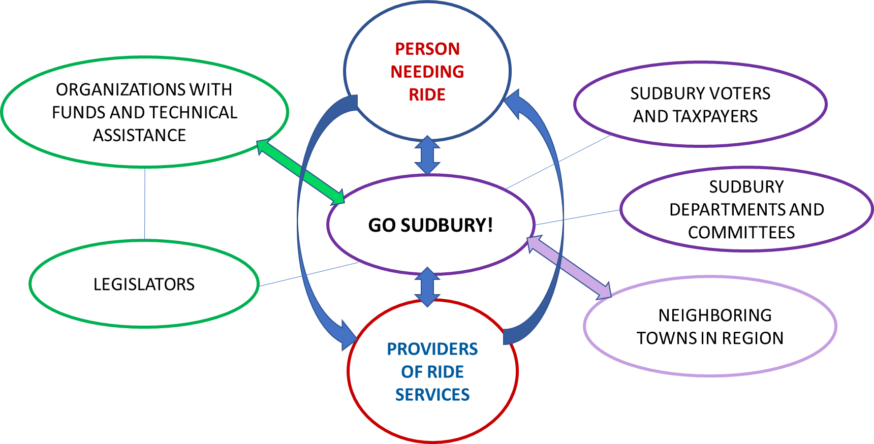
Stakeholder Review (the “who” for Sudbury)
Notes:
Briefly, with regard to transportation, the needs assessment concluded that transportation was Sudbury’s biggest challenge, and that gaps…

Slide 10
Stakeholder Review (the “who” for Sudbury)
MOVE TO APPENDIX
Notes:
Briefly, with regard to transportation, the needs assessment concluded that transportation was Sudbury’s biggest challenge, and that gaps…

Slide 11
Ties to Sudbury Master Plan (the “why”)
Master Plan Action Matrix
https://sudbury.ma.us/planning/wp-content/uploads/sites/328/2021/10/Action-Plan.pdf?version=bb570f61cd5a9e6ca4ffa9cbe705a6e9
Direct ties to multiple action items (and indirect to many more)
ROUTE 20 CORRIDOR A7, B1, B4
TRANSPORTATION AND CONNECTIVITY A2, A3, E1, E4, E5, E6
TOWN FACILITIES SERVICES, INFRASTRUCTURE A1, D5
RESILIENCY C3
PUBLIC HEALTH AND SOCIAL WELL BEING D1, D2
Notes:
Briefly, with regard to transportation, the needs assessment concluded that transportation was Sudbury’s biggest challenge, and that gaps…

Slide 12
Five Year+ Vision (the “how” and “when”)
Type of Initiative | FY22-3 | FY23-4
Services Provided | GoSudbury! Uber and Taxi (current) | GoSudbury! Connecting (to RTA/MBTA)
Proof of concept | • In-town short fixed routes • Destination fixed routes • Microtransit spoke-to-(few) hubs | • In-town short fixed routes • Destination fixed routes • In-town fixed routes to RTA connections • Microtransit spoke-to-(multiple) hubs
Medium-term |  | • Incorporation of (few) employer transit partners • Incorporation of (few) social service org. partners
Long-term |  | • In-town and destination fixed routes to RTA, MBTA, commuter rail connections • Microtransit spoke-to-fixed route hubs to RTA, MBTA, commuter rail connections
Additional Resource's req’d for Sudbury | n/a | Level funding from FY23; $100,000
Engage with: | Planning Board/Dept-Master Plan MWRTA - CatchConnect? Partner towns | DEI, Energy (MPO "Destination 2040 Vision, Goals, and Objectives"), partner towns
Help Needed (e.g. legislators) | MPO/CTPS Tech Assistance (feedback due Oct 1) | State MPO / State DOT Select Board / Town Manager State Legislators
Challenges | Sudbury "head start" over other towns, CTC role, municipal home rule issues, MWRTA change in leadership, cross-RTA travel, town staffing challenges | Municipal home rule issues, RTA collaboration, town staffing challenges
Notes:
Briefly, with regard to transportation, the needs assessment concluded that transportation was Sudbury’s biggest challenge, and that gaps…

Slide 13
Five Year+ Vision (the “how” and “when”)
Type of Initiative | FY24-5 | FY25-6
Services Provided | GoSudbury! Connecting (to RTA/MBTA) | GoMAGIC! (similar services with regionalization across MAGIC Communities)
Proof of concept | • Throughtown fixed routes • Throughtown microtransit spoke-to-hubs • Workforce development routes (transit for employees) | • Throughtowns fixed routes • Throughtowns microtransit spoke-to-hubs • Workforce development routes include day (child, adult) care
Medium-term | • Incorporation of (multiple) employer transit partners • Incorporation of (multiple) social service org. partners | • Transportation system infrastructure determined
Long-term | • Regional workforce development transportation system ID’d • Multiple employer/social service org. incorporated in system planning, design | • Regional workforce development transportation system designed, planned, spec’d • Multiple employer/social service org. partner with transit providers
Additional Resource's req’d for Sudbury | $150,000 (FY23 NPV) + Addition of part time staff | $175,000 (FY23 NPV) + Additional services
Engage with: | RTAs, Commercial/Healthcare partners, partner towns | RTAs, Commercial/Healthcare partners
Help Needed (e.g. legislators) | State MPO / State DOT Select Board State Legislators | State DOT Federal (FTA)
Challenges | Municipal home rule issues, partner town staffing challenges
Notes:
Briefly, with regard to transportation, the needs assessment concluded that transportation was Sudbury’s biggest challenge, and that gaps…

Slide 14
Five Year+ Vision (the “how” and “when”)
Type of Initiative | FY26-7 and beyond
Services Provided | GoMAGIC! (similar services with regionalization across MAGIC Communities)
Proof of concept | • Regional fixed routes • Regional micro-transit spoke-to-hubs • Workforce development routes include day (child, adult) care, education, training, etc.
Medium-term | • Transportation system infrastructure designed, planned, spec’d
Long-term | • Portions of region pilot system and follow plan, do, study, act (CQI process)
Additional Resource's req’d for Sudbury | $200,000 (FY23 NPV) + Additional services
Engage with:
Help Needed (e.g. legislators) | State DOT Federal (FTA)
Challenges | TBD
Notes:
Briefly, with regard to transportation, the needs assessment concluded that transportation was Sudbury’s biggest challenge, and that gaps…

Slide 15
Conclusion / Next Steps
Request level funding for FY23/24 i.e. $100,000
Feedback from Select Board to Transportation Committee to proceed and attempt to grow program
Notes:
If, and this is the first of the two questions, there is Town commitment to transportation services, then the next steps would involve at a minimum the following inquiry…
Please note that the Committee is committed to helping transition to a sustainable model and has already begun exploration of the above…

Slide 16
Stakeholder Review (the “who” for Sudbury)
MAPC: Metropolitan Area Planning Council
A state regional planning agency
Its transportation department promotes sustainable transportation & infrastructure
Boston region MAPC has 101 muni’s including Sudbury
Sudbury’s sub-region of 13 towns is Minuteman Advisory Group on Interlocal Collaboration - MAGIC
MPO: Metropolitan Area Organization
Federally required
Transportation policy-making
Boston region MPO has 97 muni’s, including Sudbury
22 MPO’s work with MassDOT under Executive Office of Transportation
Similar boundaries as Regional Transit Authority areas
Notes:
Briefly, with regard to transportation, the needs assessment concluded that transportation was Sudbury’s biggest challenge, and that gaps…

Slide 17
Deb’s use cases as appendix

Slide 18
Master Plan link as appendix

