Slide 1
GoSudbury! Transportation Programs
Update to Select Board, 19 October 2021
Notes:
Thank you for allowing the Sudbury Transportation Committee to share the status of the town’s transportation programs, since our prior presentation at the end of March. At that time, we had just concluded the first MAPC emergency taxi grant and were preparing to roll out an Uber pilot. Although we knew we have been funded by the second MAPC emergency taxi grant, we and our collaborating towns had not begun the project, and our Making the Connections Community Compact grant with five other towns was just getting underway.
Today, we are bringing you up to date on the latter initiatives, with the objective of seeking your commitment to, and assistance with, the sustainability of these efforts.

Slide 2
Agenda
Brief background (slides 3-5)
Current reality (slides 6-7)
Initiatives underway (slides 8-14)
Accomplishments (slides 15-17)
Lessons learned (slides 18-19)
Sustainability (slides 20-23)
Conclusion: Next Steps?
Notes:
I don’t want anyone to worry about the number of slides. A fraction of them will be the focus of our discussion, but the entire slide deck presents the full picture of what we have done and where we stand.
Because our overall goal for tonight is the issue of “sustainability,” we will be sharing a lot of information and data about our results thus far.

Slide 3
History
The Sudbury Transportation Committee was created by the Select Board to address a key feature of livable communities: transportation. A livable community is defined as
…one that is safe and secure, has affordable and appropriate housing and transportation options, and offers supportive community features and services. …Well-designed, livable communities promote health and sustain economic growth, and they make for happier, healthier residents — of all ages. http://www.aarp.org/livable-communities/net-work-agefriendly-communities/info-2014/an-introduction.html
Notes:
Background: brief verbal reminder of relationship between Livable Sudbury needs assessment and Transportation Committee (slide 3), findings of that needs assessment (slide 4), and intent that committee was designed to be temporary (slide 5)
Remind all that Sudbury was part of the MAGIC (Minute Man Advisory Group on Interlocal Coordination—part of MAPC) region’s application to, and acceptance in, the WHO/AARP age-friendly network in 2018.

Slide 4
Livable Sudbury Findings
Transportation gaps reduce the overall “livability” and long-term attractiveness of the town; they limit
Social participation
Access to community and health services
Housing options
Access to outdoor spaces
Civic participation and employment
Social inclusion.
Notes:
Briefly, with regard to transportation, the needs assessment concluded that transportation was Sudbury’s biggest challenge, and that gaps…

Slide 5
Committee Charter
The Select Board will review the contributions of the Transportation Committee in the spring of 2019 to assess how the Committee has fulfilled its role and to decide whether this structure should be continued until spring of 2020. It is en-visioned that the Committee’s purpose and tasks will become part of the responsibilities of town departments or bodies by spring 2020. The Transportation Committee, in cooperation with the Town Manager or her designee, will provide recommendations on how to integrate these responsibilities within Town Government.
Notes:
Again, in brief, this committee, established in 2018, was designed to be temporary. And, again, our goal with this presentation is to start the process by which the work of a temporary organization (Transportation Committee) can be integrated into a sustainable function of the town.

Slide 6
The Current Reality
Sudbury described as car-dependent “transit desert”
Sudbury--along with Bolton, Boxborough, Carlisle, and Stow-- classified as rural; thus, very difficult to justify mass transit
Increasing senior population: aging-in-place PLUS in-migration to age-restricted developments, ADUs, etc.
Increasing financially vulnerable population: affordable development expansion (Chapter 40B) and “housing cost burden” of seniors aging-in-place
Overall increase in number of people with disabilities (physical, psychological, cognitive) impacting ability to drive
Notes:
Current reality (slide 6)—review of facts facing the town today, despite transportation initiatives that will be described.

Slide 7
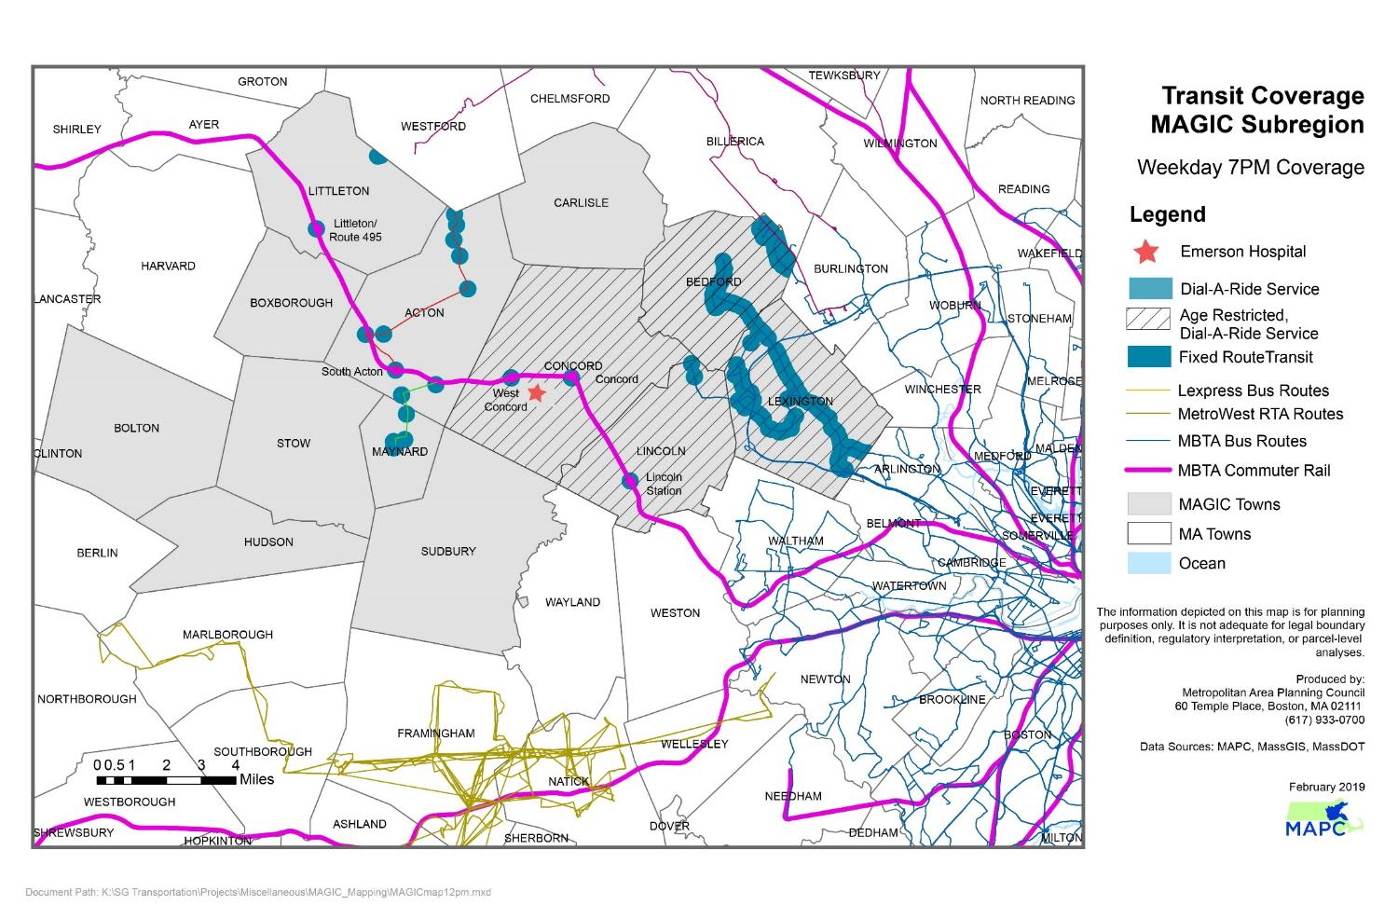
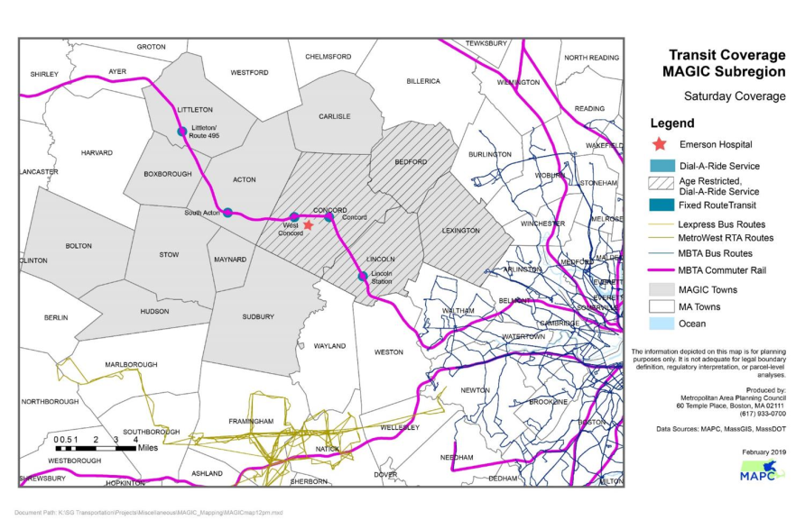
Transit Deserts (MAPC Data)
Notes:
Also current reality: Designation as “transit desert) is by MAPC (slide7); also part of current reality is that “mass transit” (public transit) alone cannot meet the needs of rural and suburban areas. In 2019, MAPC conducted assessment of role of microtransit as complement to public transit, in order to close transportation gaps in our region.

Slide 8
Initiatives Underway and Funding
Sudbury-only Funding
$23,050 MAPC COVID-19 Emergency Taxi Grant 1
Sudbury contracted with Tommy’s Taxi and JFK Transportation (concluded 28 February 2021)
$25,000 Meadow Walk mitigation, $10,000 Coolidge Phase 2 mitigation, $5,000 BayPath grants
MAPC taxi grant supplement
GoSudbury! Uber Rides Program Pilot (2021), part of Making the Connections (in process)
Shared Funding
$80,000 Multi-town Community Compact Cabinet Grant (2019)
“Making the Connections:” Sudbury, Acton, Bolton, Concord, Maynard and Stow; using microtransit to supplement CoA and RTA services (in process)
$100,000 MAPC COVID-19 Emergency Taxi Grant 2 (2021)
Sudbury ($31.3K), Concord ($15.6K), Maynard ($19.3K), Stow ($28.8K), contracting with Tommy’s Taxi and JFK Transportation (in process)
Notes:
Initiatives: now we come to the first key part of presentation, which is to share the impressive results of transportation services provided to our residents. In this slide we show again what we presented last March: two “buckets” of funding…
Shortly, we will present graphs showing funds by Sudbury sources vs. external sources—another way of looking at the finances of these initiatives.

Slide 9
Focus of Initiatives
Current focus for all transportation initiatives: meeting priority destinations for those most in need
Priority destinations:
Healthcare and social services,
Shopping, community resources, and work.
Residents most in need:
Over age 50 years
With disability (temporary or permanent)
Veterans
Financially vulnerable
Notes:
As noted in the March presentation, emphasize the appropriate but very narrow focus of initiatives… one of the reason s for narrow focus is stated goal of grants (CCC, MAPC), more recently (2020) exacerbated by pandemic.

Slide 10
Services to Date
Nearly 200 people registered for GoSudbury (9/20-9/21)
Of these (multiple categories apply):
53% Age 50+
47% Taxi riders with disability
29% Uber riders with disability
25% Financially vulnerable
More than 2,000 rides provided by taxis and Uber
Healthcare/social services (dialysis, therapy, etc.)
Shopping (grocery, Rx, etc.)
Community resources (Town Meeting, etc.)
Work
Notes:
The next 5 slides present data on the taxi and Uber programs in particular. I ask that you hold questions until the conclusion of these slides, when I will stop for comments, etc..
Last March, we told you about 82 registered riders and about 800 one-way trips; we have more than doubled those numbers in the past 7 months because we now include Uber services
As you can see from these data, we have been very successful in helping those most in need, with transportation to the most necessary destinations.

Slide 11
Monthly Rides by Mode
 | 2020 | 2021
Mode | Sept-Dec Monthly Avg | Jan Monthly Avg | Feb Monthly Avg | Mar-Sept Monthly Avg
Taxis (JFK and TT) | 137 | 137 | 137 | 38
WAV (included w/ JFK) | 6 | 6 | 6 | 2
Uber |  |  | 98 | 98
CoA Van |  |  |  | 97
Due to pandemic, taxis were only mode of transport through Jan 2021.
60% of total taxi cost paid by MAPC grant; remainder from town mitigation and Baypath grant.
Second MAPC grant awarded winter 2021; service reduced to medical only rides starting March 2021.
Uber pilot began Feb 2021 (funded from Meadow Walk mitigation).
Vulnerable riders triaged to taxis; Uber used for medical/healthcare, shopping, work, community resources.
ConA vans started back up March 2021; restricted to 1 person per trip due to Covid. Dial-A-Ride started back up in June 2021.
Notes:
This is a good overview of the importance of taxis during the initial stage of the pandemic (they were the only provider during those months in the table); and how Uber was rolled in and subsequently the CoA vans (which still are restricted to one person per trip). Thus, including CoA vans, we have provided more than 2,500 trips—again, to the most needy riders and most vital destinations—from Sept 2020 to Sept 2021.
(Go over footnotes.)
Emphasize that disability numbers are higher than simply wheelchair-accessible rides indicate

Slide 12
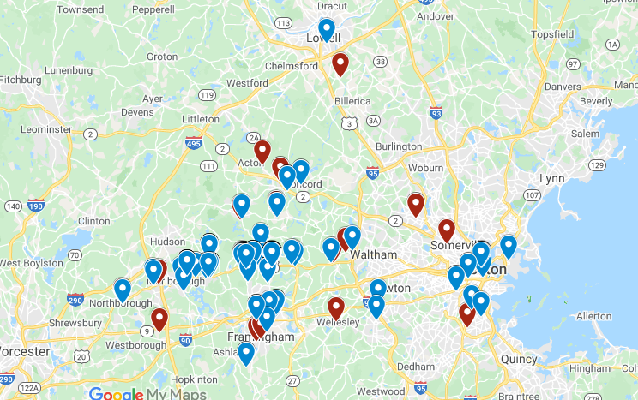
Uber Ride Geography
Heavy usage up and down Route 20
Repeat rides to medical appointments, in particular dialysis centers
Food shopping
Some longer rides, but majority short distance
Notes:
Just a brief illustration of the data we are collecting and the utility of the information for future solutions to the transportation challenges (e.g., route 20 corridor; certain highly traveled healthcare routes, etc.)
NOTE – there may be multiples rides per pin location!

Slide 13
Uber Example, September
Number of rides: 166
Average distance: 11 miles
Average ride duration: 23 minutes
Average fare: $27
Average wait time: 15 minutes
Rider qualifying categories
50+ years = 80 (53%)
Limited financial means = 27 (18%)
With disability = 43 (29%)
Healthcare destinations
Mass General Hospital
Boston Medical Center
Emerson Hospital
Harvard Vanguard/Wellesley
Dana Farber
Notes:
An additional example of, again, one month of Uber rides and the focus on rider needs/destinations.
Stable and more predictable with larger numbers (more drivers, etc.)

Slide 14
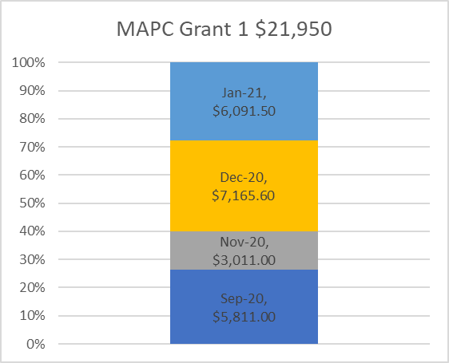
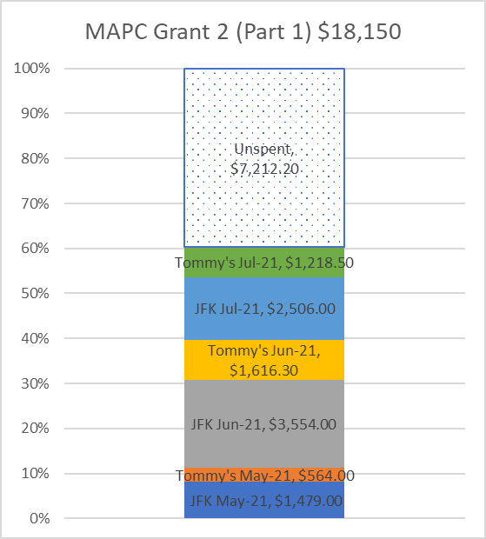
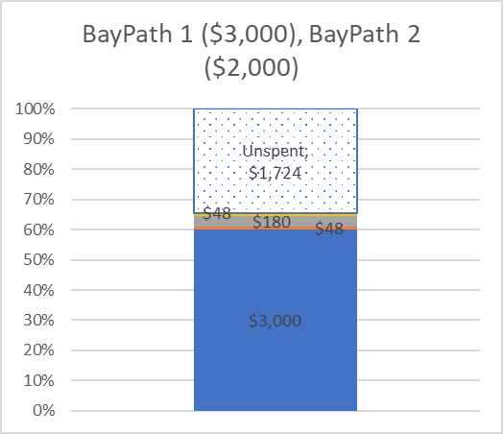
Data Collected - Finances
Notes:
An example of how closely we are monitoring funds; these graphs do not show where the external (outside Sudbury) funds have been spent, but obviously we have that data as well.
DEVELOPMENT – Bay Path money spent 10/14/2021
Sept 2160…Oct 3651…came as one bill

Slide 15
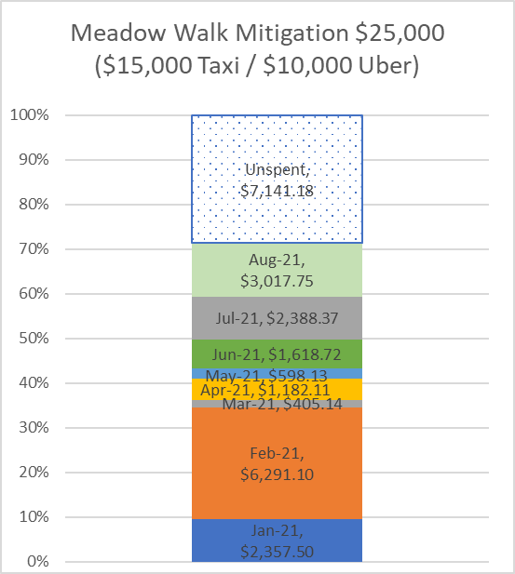
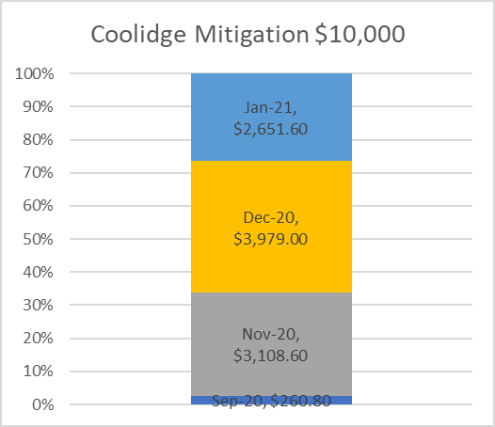
Data Collected - Finances
Notes:
Example of the “inside” money from Sudbury sources.

Slide 16
Accomplishments
Livable Sudbury (2019)
Transportation = crucial
Families with children under 18 years
Residents age 60+
Residents with participation limitation
Financially insecure residents
42% of persons with disability “had missed, canceled, or rescheduled a medical appointment due to lack of transportation.”
More than a third of financially insecure residents not satisfied with their “ability to get where they want to go.”
Nearly half of residents 60+ not satisfied with their “ability to get where they want to go.”
GoSudbury! (2021)
Most needy residents served:
Residents age 50+
Residents with a disability
Residents with financial limitations
Most vital destinations reached
Healthcare
Shopping
Community resources
Work
Notes:
How do we judge our results? One test is whether we are addressing what the livable Sudbury needs assessment found:
Clearly, a major accomplishment was effectively providing necessary transportation services. Again, we focused on most needed (age, disability, financial insecurity) and the most vital destinations (see challenge facing people with disabilities) and, on this basis, met crucial objectives.
Clearly, though, there are still gaps and unmet needs.

Slide 17
Resident Feedback
“Being new to the town and being a non driver, I relied on this service to get around and stay connected to life. Without it I’ve had to walk to get my groceries and buy only what I can carry and I feel isolated from my friends.”
“It provided me with much needed service. The ability to get a [wheelchair accessible] ride that could go out of Sudbury gave me many more options and places to go. This helped my physical and emotional well-being that I was not trapped in town.”
“X is a kind and competent driver. He is not only always on time, he is always early. He is also patient. I’m so happy to use this as it is the best and easiest way for me to get to important medical appointments. It makes a huge difference in my life. It is one of the many things needed to allow me to continue to live in my own house.”
“I was very happy for the service. It was offered at a difficult time in my life when no one was around to help me out. Everyone was wonderfully helpful, from Ana to Beth to all the drivers, including office dispatchers for the taxi companies. Thank you for this taxi service. It was a life saver in my case.”
Notes:
A second test of our results comes from the people we served. From these comments, we were able to make a difference in people’s lives.
(a few of the verbatim comments from feedback solicited at the conclusion of the first MAPC taxi grant)

Slide 18
Accomplishments, cont.
Sudbury is leader and role model in:
Livable communities (MAGIC) providing transportation options
Vendor relations and partnering (taxis, Uber)
Community Compact 6-town collaboration
MAPC taxi grants (demonstrated success in 2 rounds, option for 3rd)
Notes:
A third test of our results is found in the town’s status, now, as leader and role model for other similar communities.

Slide 19
Lessons Learned
Preparation (Transportation Committee invested 3 years preparing for initiatives)
Continuous quality improvement (Early stage of each initiative was followed closely, with improvements made immediately as needed: plan, do, study, act)
Scientific approach (Focus on data, including rider and vendor feedback [hypothesis testing])
Notes:
I want to pull together the Committee’s own inquiry and reflection on judging our results in this and the next slide.
We believe there are three major reasons why town has been successful thus far… although we officially meet every 2 weeks (or weekly, when necessary), please be aware that an enormous amount of work goes on between meetings. This will become clearer shortly.

Slide 20
Lessons Learned, cont.
Only most needy residents (and most vital destinations) served. Many more would benefit from choices other than own auto.
Environmental considerations are pressing (EVs, pooled transport, etc.).
Mobility (WAV) and assisted options still very limited.
Grant funding unpredictable, unsustainable.
Transportation management should be Town Staff responsibility, less reliance on volunteers.
Notes:
We also reflected on what constraints we faced, even if our results are impressive.
Let me ask if questions on these 2 slides? We are about to go into the discussion of the goal of this presentation…

Slide 21
Target State: Sustainability
2019 Livable Sudbury needs assessment: Transportation is the town’s biggest challenge.
Sudbury now at crucial stage:
Is there Town commitment to a sustainable, effective, and efficient system of transportation for residents?
If yes, how do we ensure a sustainable, effective, and efficient system of transportation for residents?
Notes:
Crucial stage: how sustain, given (in following slides) what is required to provide transportation services… The only answer we need, soon, is to the first question (and, that answer requires more time and process than expected in a Select Board meeting, but we need to start that process now). At the end of this presentation, together we can determine what the process might entail… With regard to the second question, the following several slides should help inform what is at stake…

Slide 22
Significant Program Requirements
Management:
Grant writing and management
Oversight of grants (tactical and financial performance)
Relationships/communications with vendors, grant providers, other collaborating towns
Data gathering and reporting on services provided
Coordination:
Day to day work with participants in the program
Technical assistance with registration, application, use of service (taxi dispatch, Uber smartphone app)
Education of users about all transportation options
Referral to Uber Tech help volunteers
Troubleshooting issues
Notes:
Here are the slides we will NOT dwell on, but which are included so that the slide deck presents a coherent illustration of the issues… With thanks to Debra Galloway and input from staff and committee, here is what is required to provide services, and here is what the committee—town staff and volunteers—actually did over the last 3 years…
Day to day work – for example Ana C – 300 hours!

Slide 23
Requirements, cont.
Making the Connections Community Compact
Regional meetings organized by Sudbury as lead of 6 towns
Communication with other town leadership/planning
Implementation of RFP for consultants, etc.
Communication with Program Manager consulting firm
Reporting to town and other entities on services provided
MAPC COVID-19 Urgent Taxi Grants 1 and 2
Taxi company relations
Creation of online application and database
Management of online database
Client relations and tech assistance

Slide 24
Requirements, cont.
GoSudbury! Uber Rides Program Pilot
Uber contract management
Creation of online application and database
Management of online database
Client relations and tech assistance
Uber user contact re: technical assistance, trouble shooting, access for visual or other impairment issues
Education about transportation options
Other
Senior Center has two van drivers who provide the Sudbury Connection van service
Senior Center provides the Sudbury Connection van service in conjunction with the MWRTA
Notes:
Between meetings continuous work

Slide 25
Next Steps?
Explore options for
Staffing
Who, what department(s), role/responsibilities
Financing
Tax levies, mitigation, copay, vouchers, grants
Service provision
Separate vendors or full-service, link with RTAs, CoAs, etc.
Notes:
If, and this is the first of the two questions, there is Town commitment to transportation services, then the next steps would involve at a minimum the following inquiry…
Please note that the Committee is committed to helping transition to a sustainable model and has already begun exploration of the above…

Slide 26
Appendix
Census Data for Sudbury, 2010 vs. 2020
From https://www.sec.state.ma.us/census2020/index.html
Housing units rose from 5951 to 6556 (+10.2%)
Population rose from 17,659 to 18,934 (+7.2%)
Population under 18 dropped (-9.3%)
Population 18+ rose (+15.0%)
Notes:
The town is close being built-out, but there are age-restricted and affordable developments such as Quarry North that can have big impact.

