Slide 1
Minuteman Advisory Group on Interlocal Coordination
UPDATE ON THE TAXI INITIATIVE
NEXT sTEPS?

Slide 2
Agenda
Three parts:
Review of initial project and alignment with goal of livability
Exploration of microtransit sector
  Definition
  Example microtransit platform companies
Options and discussion
  MAPC and RFI
  MAPC and grants

Slide 3
Initial Project Review
Taxi, bus, livery initiative
Purpose: Solve persistent transportation needs in our car-dependent region via creative solutions (e.g., smart technology)
Focus: Provide subsidized on-demand options for seniors, people with disabilities, residents who are economically vulnerable; PLUS market-rate on-demand services (cross-subsidy)
Partnering: Towns (6); taxi, bus, livery companies (11); RTAs (3); TMA (1)

Slide 4
1 (cont). Alignment With Goal of Livability
April 2018 acceptance of MAGIC towns in AARP/WHO Livable Communities network
MAGIC commitment: “two particularly pressing issues: housing and transportation”
Sudbury assessment: transportation is paramount-- affects all other livable domains, directly or indirectly
  Housing, a vital element, cannot be addressed without considering transportation implications
  CHNAs have identified social isolation (transportation implied) as well as medical transport as crucial needs

Slide 5
2. Exploration of Microtransit Sector
Definition: small rider numbers per vehicle, variable routes, pick-up and delivery adjustments in real time (complement to mass transit = large rider numbers, fixed routes, fixed schedules)
Mode agnostic: Bike share, car share, CoA vans, Dial-a-Ride, etc.
Evidence: Microtransit approach responds effectively to transportation challenges like ours, that cannot be solved with mass transit only
Livability: Effective microtransit services improve accessibility (meets needs of mobility challenged), reduce transit authority costs (vehicle use optimized, ridership expands), increase regional and indi-vidual economic opportunity (employee access to work, customer access to retail), lessen social isolation, and provide ability to respond (change/innovate) in real time

Slide 6
2 (cont). Sector Companies
Niche companies providing focused software to help RTAs integrate micro- and mass transit:
Via: “Passengers request rides through a mobile app and Via’s sophisticated algorithm instantly finds a vehicle that best matches their route, allowing for quick and efficient shared trips. First launched in New York City in September 2013, the Via platform currently operates in New York City, Chicago, and Washington DC.”
RideCo: “Recently awarded a contract from Los Angeles Metropolitan Transit Authority for microtransit technology and design services. … The service will offer current and future Metro customers the ability to use cell phones to order, pay for and monitor the status of their pick-up and drop-off in Metro vehicles.”

Slide 7
2 (cont). Companies
TransDev: “Taxis and private hire provide individualized choice for passengers. With a solid presence on the taxi market in the United States, Transdev is the biggest operator in Baltimore, Denver, Pittsburg, and Kansas City.”
TransLoc: “Currently owned by Ford Smart Mobility, … the company’s intuitive cloud-based software system and our expert microtransit support team are here to get you up and running quickly, while minimizing any operational burdens and expense. Administrators are able to set up user accounts within minutes of receiving rider data, offering seamless onboarding for all passengers.”
Zemcar: “Zemcar was built so families could enjoy the convenience and flexibility that rideshare companies provide without compromising the safety of their most precious cargo. It all starts with our ZemDriver onboarding process.”

Slide 8
3. Options
Establish formal task force to work with MAPC on RFI and examine microtransit companies pursuant to decision
Establish formal task force to work with MAPC on applying for grant(s)—regionalization and efficiency,

Slide 9
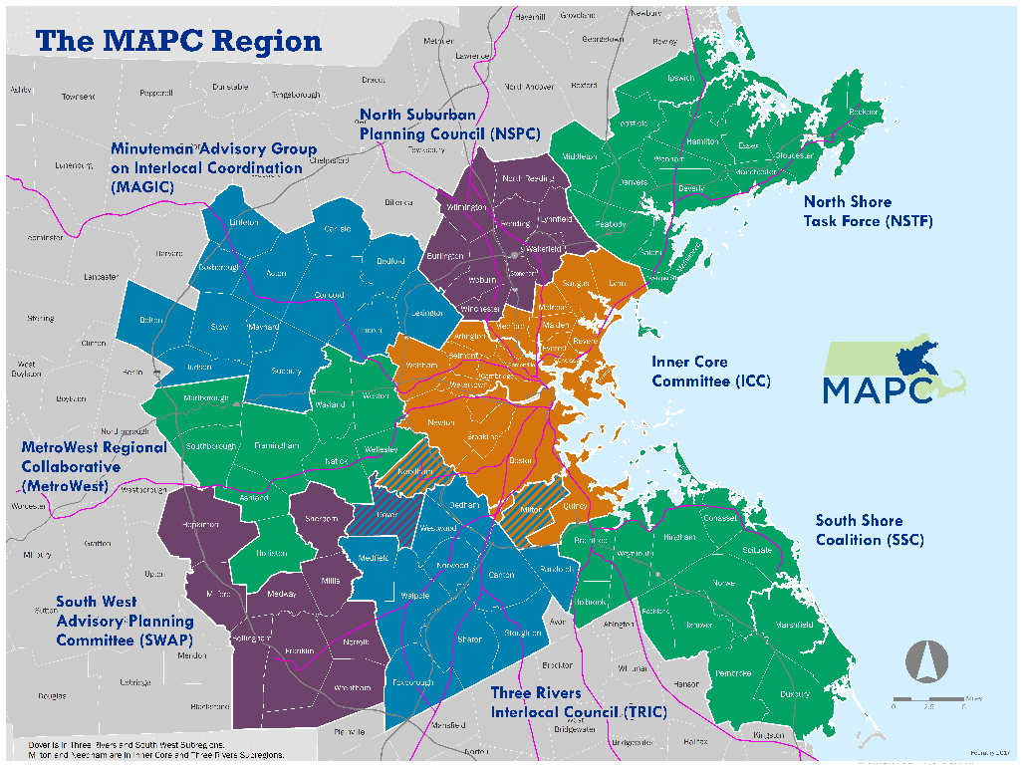

MAPC Discussion
MAPC
Proposed
Technical Assistance
September 6, 2018

Slide 10
Proposed Technical Assistance
MAPC lead role in drafting and administering microtransit Request for Information (RFI).
  MAGIC reps 1.) help generate questions for vendors, 2.) review draft RFI, 3.) review responses from vendors
  Timeline: September – October draft RFI; RFI submissions due November; responses and findings December/January

Slide 11
Proposed Technical Assistance
MAPC lead role in drafting grant application for Efficiency and Regionalization grant to seek funding to implement on-demand transit pilot.
  MAGIC reps review draft application materials
  Current study and needs analysis populates application
  MAPC convenes RTAs and others as collaborators
  If grant awarded, MAPC assists with RFP process in 2019
  Timeline: October-December coordinate with RTAs and TMA in preparation for grant application; January-February draft application

Slide 12
Proposed Technical Assistance
If support for proposal:
  MAPC draft scope of services with roles, deliverables, schedule
  MAGIC support efforts with $10,000 in Special Assessments funding

Slide 13
Examples of MAPC Technical Assistance

Slide 14
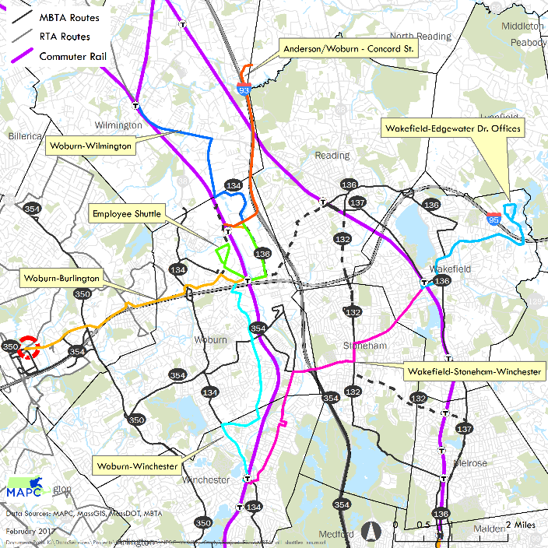
North Suburban Mobility Study (2017)
Transit needs and suitability analysis for subregion (work trips)
Recommendations: local shuttles, mobility hubs, ride-hail partnerships
Three communities looking to join or start TMA to begin pilot
Mobility Studies

Slide 15
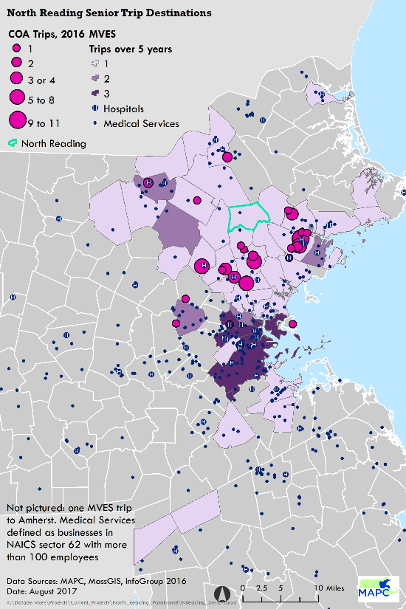
North Reading Paratransit Study (2017)
Assessed unmet senior and other trip requests
Town-wide survey via tax bill and online
Town began pilot program with new service from Merrimack Valley RTA for out of town medical trips
Mobility Studies

Slide 16
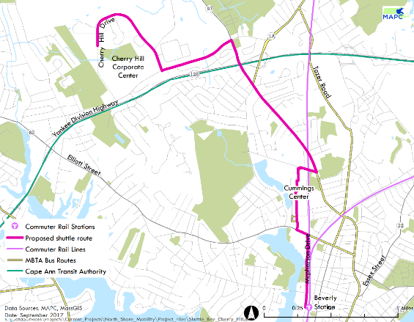
North Shore Coalition Mobility Study and Pilot
(2017-2018)
Needs and suitability assessment for work trips (first/last mile)
Recommendations: mobility hubs, local shuttles, on-demand transit expansion, bicycle share
Through MAPC, received E&R grant to pilot employer-sponsored shuttle in Beverly/Danvers
Regional bicycle share being evaluated
Mobility Studies

Slide 17
North Reading Satellite Shuttle Evaluation
(underway)
Evaluating feasibility of shuttle connecting North Reading to commuter rail
Suitability analysis of shuttle routing and parking sites
Capital and operating cost assessments
Mobility Studies

