Slide 1
Bruce Freeman Rail Trail Design Task Force
Recommendations Report
March 21, 2017
Board of Selectmen Meeting

Slide 2
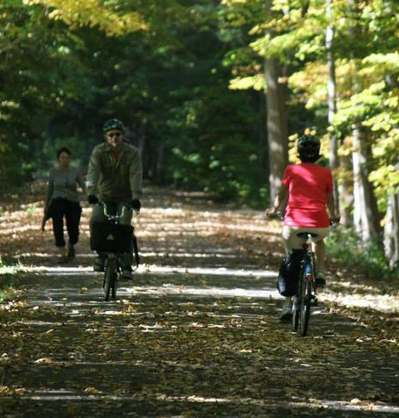
Outline
Task Force Overview and Goals
Task Force Methods and Outreach Efforts
Task Force Meetings
Outreach to Interest Groups
Meetings with Abutters
Public Information Meeting
Recommendations
Alternative Routes
Rail Trail Surface
Rail Trail Standard Width
Treatment in Challenge Areas
Roadway Intersections
Additional Investigations

Slide 3
BOS Mission Statement for Task Force
The responsibilities of the Task Force will include the following:
Gathering input from Town Boards and Committees including the Conservation Commission, the Community Preservation Committee, and the Park and Recreation Committee;
Gathering input from the Town’s public safety and engineering staff concerning traffic and safety issues with the BFRT, especially where the rail trail intersects with roadways;
Soliciting community input through open and noticed meetings; Facilitating meetings of the Task Force with trail abutters to discuss design elements of the project that specifically affect them, which will be in addition to the meetings contractually required of VHB;
Documenting concerns and requests of abutters, businesses, and other residents;
Recommending to the Board of Selectmen potential design elements that would advance the goals of the Sudbury Wetlands Administration Bylaw, and developing alternatives along with cost estimates as feasible;
Recommending to the Board of Selectmen any specific design elements, mitigations, or realignments to address resident concerns (including those of abutters), safety concerns, or environmental concerns, along with cost estimates for such design decisions as feasible;
Submission of a report of its findings to the Board of Selectmen.
Notes:
Directly taken from the Mission Statement Responsibilities

Slide 4
Task Force Membership
Name | Position | Appointed by
John C. Drobinski | Chair | BOS
Daniel E. Carty | Vice-chair | Planning Board
Charles Russo | Clerk | Conservation Commission
Robert C. Beagan | Member | Parks and Recreation Commission
Lana B. Szwarc | Member | Friends of BFRT
Robert Schless | Member | BOS
LeRoy Sievers | Member | BOS

Slide 5
Task Force Methods and Outreach Efforts
Task Force Meetings
January 17, February 2, February 16, March 2, March 16, March 20, 2017
(6 meetings)
Sixteen meetings and/or presentations for the BFRT Design Task Force took place since the Task Force formation
Outreach to Interest Groups (6 meetings)
Received input from DPW and Fire Department: February 2, 2017
Board of Health: February 14, 2017
Planning Board: February 22, 2017
Historic Districts Commission: March 2, 2017
Council on Aging: March 9, 2017
Conservation Commission and Parks and Recreation Commission: March 13, 2017
Also engaged: Chamber of Commerce, SPS, LSRHS, Agricultural Commission, and Energy and Sustainability Committee
Meetings with Abutters: March 2, 2016 (approximately 50 attendees), plus additional two individual abutter meetings with Task Force representation
Public Information Meeting: March 9, 2017

Slide 6
Alternative Routes Considered
Notes:
History of alt. routes considered

Slide 7
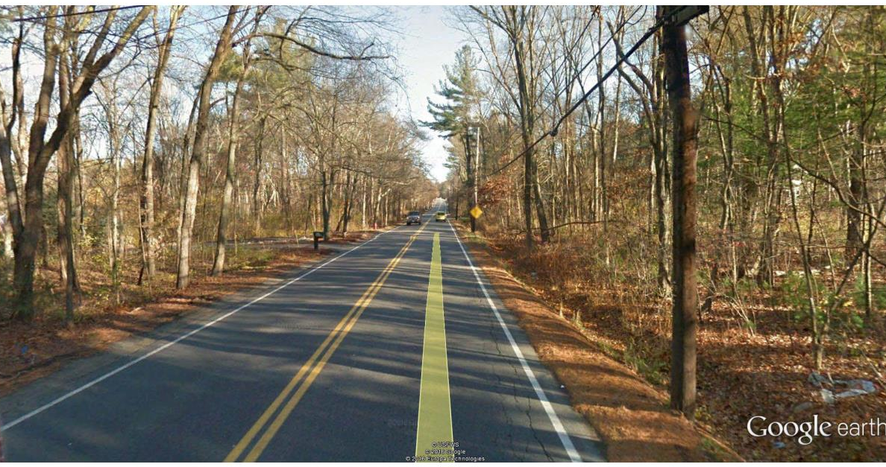
Recommendations: Alternative Routes
Alternative Routes –None of the presented roadway alternative options are considered feasible
Infeasibility is based on limited right of way, lack of abutter support, cost, safety concerns at the roadway intersections and the numerous driveway intersections, and lack of desired trail user experience
It is recommended that the Design Team continue to collaborate with the concerned businesses abutting the rail corridor to identify potentially more feasible alternatives
Union Ave
Notes:
Refer to Matrix on Alternatives prepared by VHB and public comments

Slide 8
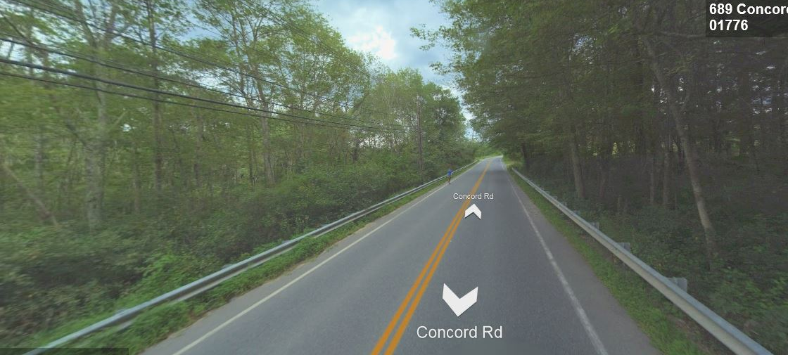
Alternative Route
Concord Road
Notes:
Refer to Matrix on Alternatives prepared by VHB and public comments

Slide 9
Recommendations: Trail Surface
Paved Surface
Considers the safety of users on a uniform surface, facilitates safety vehicle access, provides greater ease of maintenance, continuity with the BFRT to the north, and the greatest containment of potential rail road contaminants.
Bridge surface is anticipated to be paved and boardwalk surface is yet to be determined.
Notes:
Refer to DPW and Fire Chief Comments, as well as public comments

Slide 10
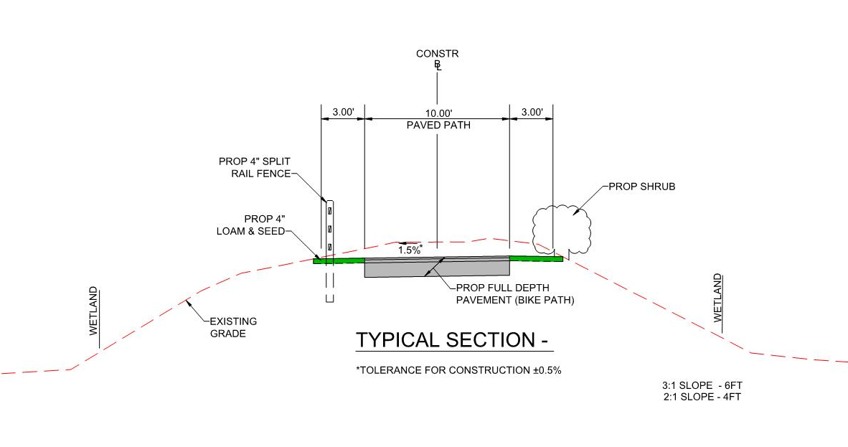
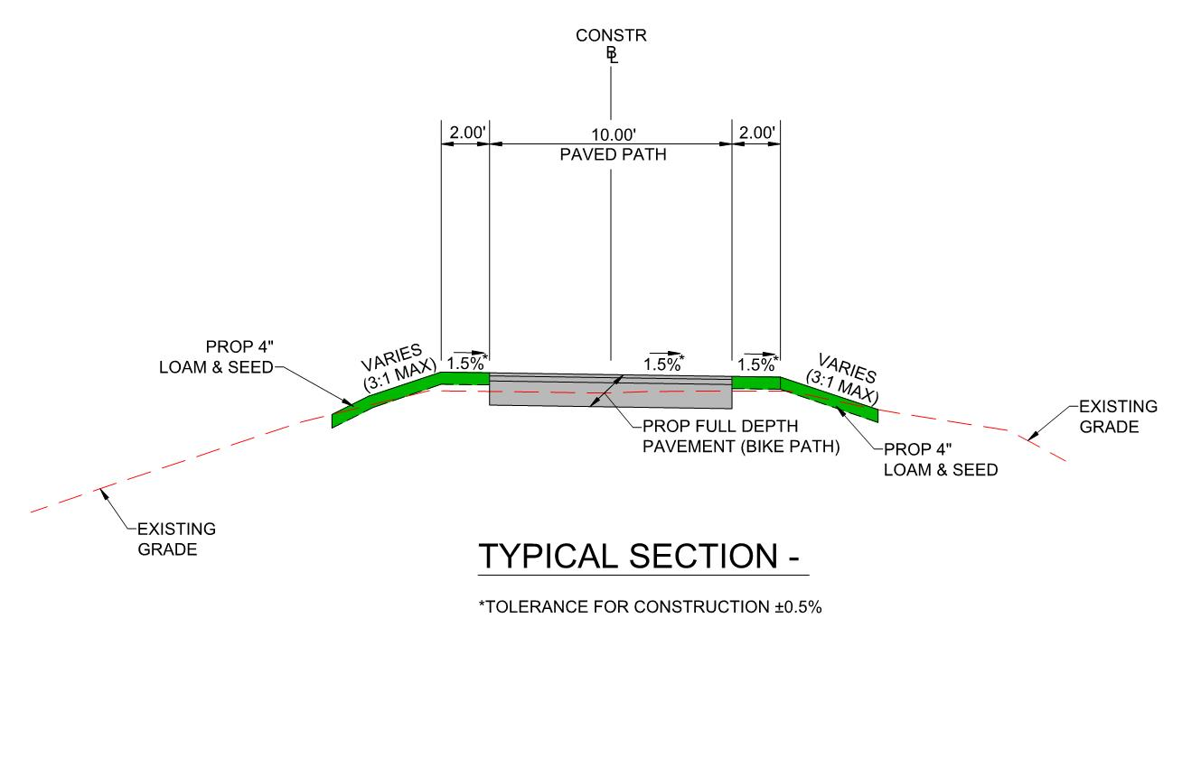
Recommendations: Standard Trail Width
Standard approach: 10-foot path standard with 2-3 foot shoulders (depending on the slope adjacent to the path and the need for a barrier). This represents a 14 or 16-foot wide layout
Notes:
Refer to Matrix on Alternatives prepared by VHB
Refer to DPW, Conservation Commission, and Fire Chief Comments, as well as public comments
Mention avoidance of variance to WPA a priority and the meeting with MassDOT where treatment options were discussed
There was not unanimous agreement of the Task Force on the treatment for the Challenge Area South of Hudson. Two members preferred the reduced width at grade option for both challenge areas. Estimated cost will be higher for boardwalk.

Slide 11
Challenge Areas (in pink)
Pantry
Brook
Bridge
2
1
Notes:
Number the pink areas and refer to those in the next slide

Slide 12
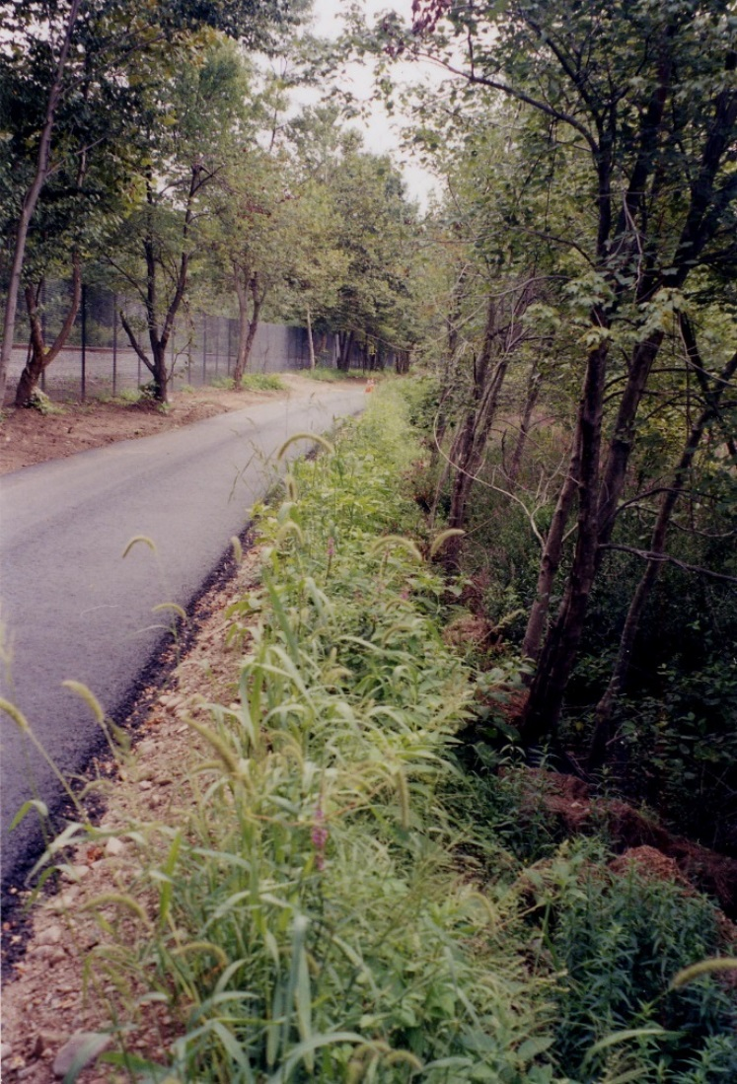
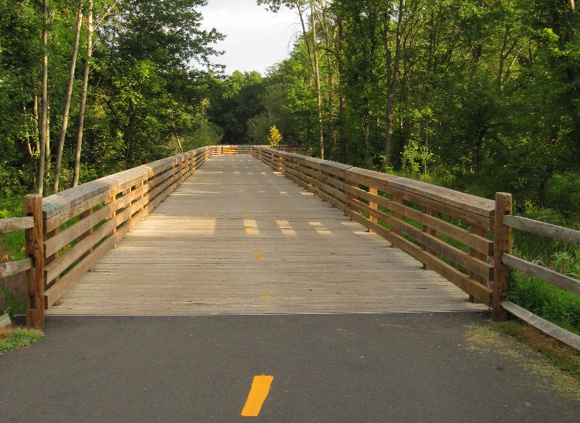
Recommendations: Treatments in Challenge Areas
Challenge area (#1) south of Hudson Road (650 ft): 14-foot elevated boardwalk
Challenge area (#2) south of North Road (1200 ft): Reduced width and retaining walls. 10-foot paved path and 1-foot shoulders.
Notes:
Refer to Matrix on Alternatives prepared by VHB
Refer to DPW, Conservation Commission, and Fire Chief Comments, as well as public comments
Mention avoidance of variance to WPA a priority and the meeting with MassDOT where treatment options were discussed
There was not unanimous agreement of the Task Force on the treatment for the Challenge Area South of Hudson. Two members preferred the reduced width at grade option for both challenge areas. Estimated cost will be higher for boardwalk.

Slide 13
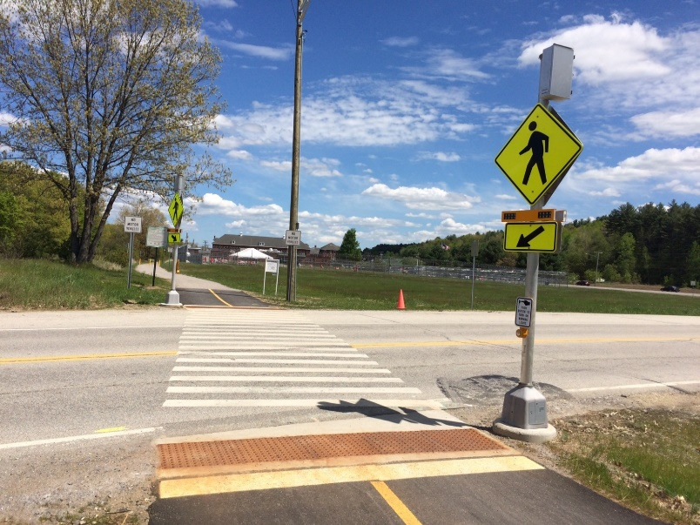
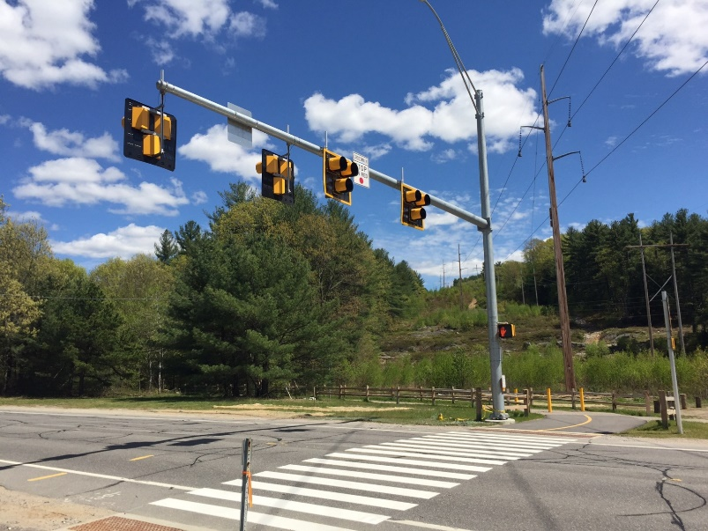
Roadway Intersections
Standard Pedestrian crossing - Methods Driveway, Codjer Lane, Morse Road, and Fairview Farm Driveway
Rectangular Rapid Flashing Beacon - Old Lancaster Road, Haynes Road, and Pantry Road
Pedestrian Signal - Hudson Road and North Road
Notes:
Refer to HDC and PB comments

Slide 14
Recommendations: Roadway Intersections
Roadway Crossings
Hudson Road: Avoid the large overhead mast arm for signals, if possible
Morse Road: consider supplemental signage to slow down vehicles and bicyclists
Pantry Road: consider supplemental signage to slow down vehicles and design needed to allow safety vehicle access
Peakham Road: concern with proposed elimination of right hand turn lane; determine appropriate intersection mitigation to protect path users; conduct further investigations of impacts to traffic; possibly look at traffic data available from proposed Sudbury Station development
Notes:
Refer to HDC and PB comments

Slide 15
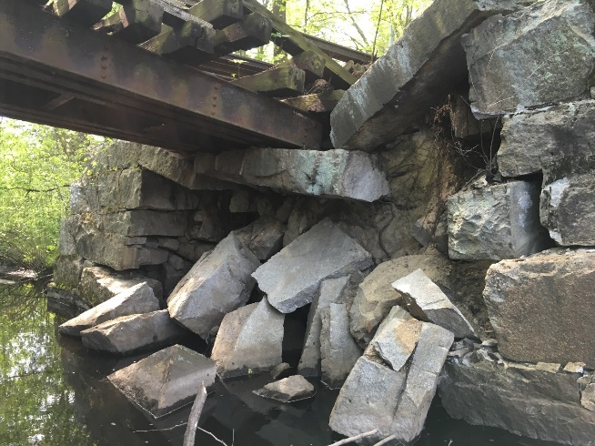
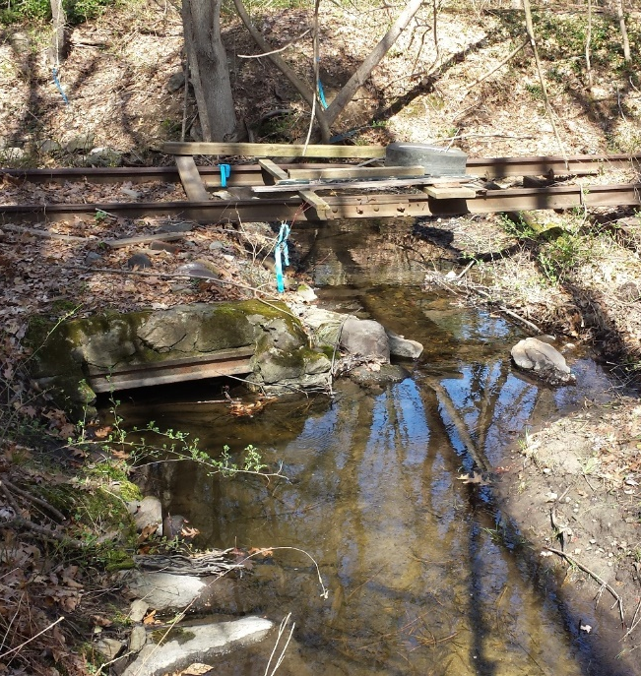
Recommendations: Additional Investigations
In the next design phase (75%):
Prepare natural resources technical memo consolidating information to supplement wetlands permitting process (see Concord example)
Upgrade culverts as needed and where there are opportunities to improve the environmental condition of streams and adjacent wetlands
Identify environmental impact mitigation options
To extent possible reuse the exiting stones from the Pantry Brook abutments and retain the cattle passages
Clarify if boardwalk design will meet H10 or H20 loading
Notes:
Many of these are already part of the design process

Slide 16
Recommendations: Additional Investigations
Ongoing
Continue to coordinate with abutters and identify suitable mitigation, in particular Cavicchio and Method’s Machine
Identify opportunities for improving the environmental condition adjacent to the corridor
Conduct outreach to interested groups and relevant Town Committees on parking and trail interconnectivity (especially schools and Parks and Recreation Commission)
Outreach to Chamber of Commerce and remaining business community
Respond to comments received

Slide 17
Follow Up Questions
Seek clarification of final report expectations
Determine next steps for Task Force

