Slide 1



Presented By:
Phyllis Schilp BSN, RN
Sudbury Board of Health Nurse
Breast Cancer
American Cancer Society
Reviewed October 2015

Slide 2
Breast cancer: How common is it?
The most common cancer in women in
the U.S.
2nd leading cause of cancer-related death in women in the U.S.
Death rates have been steadily going down since 1989.

Slide 3
What is breast cancer?
Cancer is the growth of abnormal cells.
The cells can invade and damage normal tissue.
Breast cancer can start in any part of the breast.

Slide 4
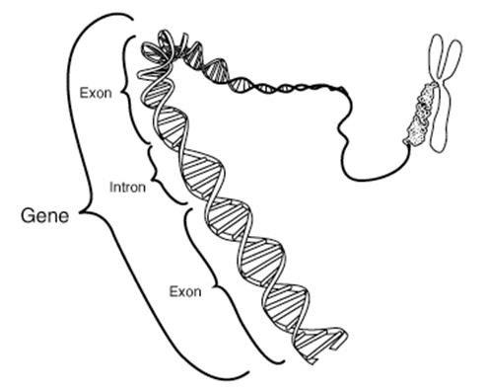
Causes of breast cancer
We do not know the cause of most breast cancers.
Most likely cause is related to changes in the genetic material (DNA) in our cells.
DNA changes are often related to our lifestyle, but some can be due to age and other factors.

Slide 5

Breast cancer risk factors
Gender
  Being a woman is the main risk factor for developing breast cancer
Aging
  Breast cancer risk increases as a woman gets older

Slide 6
Breast cancer risk factors
Genetic risk factors
  About 5% to 10% of breast cancer cases are thought to be hereditary, caused by gene changes (mutations) inherited from a parent. Having BRCA mutations inheritied.
Family history of breast cancer
  Breast cancer risk is higher among women
whose close blood relatives have this disease.
Having BRCA mutations

Slide 7
Breast cancer risk factors
Personal history of breast cancer
  A woman with cancer in one breast has an increased risk of developing a new cancer in the other breast or in another part of the same breast.
Previous chest radiation
  Women who had radiation to the chest for another cancer as a child or young adult are at a much higher risk.

Slide 8

Breast cancer risk factors
Post-menopausal hormone therapy (PHT)
  Increased risk in women who use or recently used combined PHT for many years
DES exposure
  Slightly increases risk
Recent use of hormonal contraceptives
  Slightly higher risk than in women who never used them, but this goes down after use stops

Slide 9
Breast cancer risk factors
Race
Breast cancer risk is higher among white women than African American women.
African American women are more likely to die
of this cancer.
Dense breast tissue
Women with denser breast tissue (as seen on a mammogram) have a higher risk of breast cancer.

Slide 10
Breast cancer risk factors
Not having children or having them later in life (after age 30)
Puts a woman at slightly higher risk
More menstrual cycles
Slightly higher risk if a woman started menstruation early or went through menopause later
Not breastfeeding
Some studies suggest that breastfeeding may lower breast cancer risk.

Slide 11
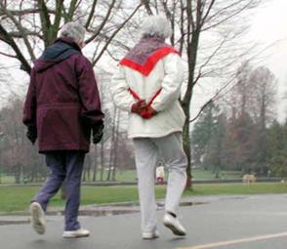


Breast cancer risk factors
Physical activity
More active → lowers risk
Overweight
Obesity → raises risk of having
breast cancer after menopause
Alcohol use
Clearly linked to increased risk
Risk goes up with the amount of alcohol you drink

Slide 12
Preventing breast cancer
How all women can lower risk:
  Get to and stay at a healthy weight
  Be physically active
  Limit alcohol use
Some women can also think about things
like
  Birth control options that don’t use hormones
  Not using hormone therapy to deal with the symptoms of menopause

Slide 13
Preventing breast cancer
There is no sure way to prevent
breast cancer.
But there are things all women can do that might reduce their risk and help increase the odds that if they do get breast cancer, it is found at an early, more treatable stage…

Slide 14
Breast cancer screening
Screening is testing to find cancer, or other diseases, early in people who have no symptoms. Monthly Breast Exams are important!!!
Screening can help find cancers when they are small and have not spread – when they have a better chance of being cured.
Breast cancer screening is done with
  Mammograms
  In some cases, breast MRI

Slide 15
ACS Recommendations for Early Breast Cancer Detection
For women at average risk for breast cancer
Women ages 40 to 44 should be able to start annual breast cancer screening if they wish to do so.
Women ages 45 to 54 should get mammograms every year.
Women age 55 and older should switch to mammograms every 2 years, or can continue yearly screening.
Screening should continue as long as a woman is in good health and is expected to live at least 10 more years.

Slide 16
ACS Recommendations for Early Breast Cancer Detection
For women at high risk for breast cancer
Women at high risk for breast cancer based on certain factors should get an MRI and a mammogram every year.
At this time, there’s not enough evidence to make a recommendation for or against yearly MRI screening for women who have a moderately increased risk of breast cancer or who are high risk based on other factors.

Slide 17

Reviewed Februa ry 2014

Slide 18
Prostate cancer: How common is it?
The cancer most often diagnosed in men in the U .S.
For reasons that remain unclear, it occurs more often in Africa n American men than in any other group.
Is the second leading cause of cancer­ related death in men in the U .S.

Slide 19
What is the prostate?
The prostate is a gla nd found only in men.
It is part of the
reproductive system and helps to make semen.
It is located in front of the rectum and under the bladder.
A healthy prostate gland is about the size of a
wa lnut.
-.
-
.

Slide 20
What is prostate cancer?
Cancer is the growth of abnormal cells.
Cancer cells can invade and damage normal tissue.
Prostate cancer starts in the cells of the prostate.
Some prostate cancers can grow and spread quickly. But most of them grow slowly.

Slide 21
Causes of prostate cancer
We do not know the cause of prostate cancer.
Most likely cause is related to changes in the genetic materia l (DNA) in our cells.
DNA changes ca n be passed down thro ugh families, or can occur due to environment or lifestyle.

Slide 22
Prostate cancer risk factors
Age
  More tha n 6 out of 10 prostate cancers are .found in men older tha n 65.
Race/Ethnicity
  African-America n men and Ja maican men of African ancestry have the highest risk a nd are more likely to be diagnosed at an advanced stage.
The reasons for these racial differences are unclea r.

Slide 23

Prostate Cancer ris k factors
Family history
Having a father or brother with prostate ca ncer more tha n
doubles a man's risk of develo ping this disease.
The risk is much higher for men with several affected relatives, particularly if their relatives were young at the time the cancer was found.

Slide 24
Can prostate cancer be prevented?
Because the exact cause of prostate cancer is not known, at this time it is not possible to prevent most cases of the disease.
Known risk factors such as age, race,and fa mily history cannot be controlled.

Slide 25

Lowering prostate cancer risk
Supplements
No vitamins or supplements have been proven to lower the risk of prostate cancer.
11
Ta king any supplements ca n have risks and benefits. Talk to your doctor before starting any vitamins or other supplements.

Slide 26
Early detection of prostate cancer
Screening is testing to find cancer, or other disease, in people w ho have no symptoms.
Screening can help find cancers in an ea rly stage w hen they are sma ll, have not
spread, and are more easily cured.
Screening for prostate cancer ca n be done with:
  Prostate-Specific Antigen ( PSA) blood test
  Digital Rectal Exam ( DR E )
11

Slide 27
Screening tests most often used
Prostate-specific antige n ( PSA)
Made by cells in the prostate gland
Most healthy men have a sma ll amount of PSA [less tha n 4 nanograms per milliliter (ng/mL)] in their blood.
Digita l rectal exa m ( DRE)
Doctor puts their gloved, lubricated finger into the rectum to feel for any bumps or hard areas on the prostate that might be cancer.
May be uncomforta ble,but causes no pain and only ta kes a short time.

Slide 28
Screening for prostate cancer
There are limits to the current screening methods:
Neither the PSA test nor the DRE is 100%
accurate.
Abnorma l results of these tests don't always mean that cancer is present, and normal results don't mean that there is no cancer.
If cancer is found, neither test can tell how likely the cancer is to grow and spread.

Slide 29

ACS Recommendations for the Early
Detection of Prostate Cancer
ACS does not support routine testing for prostate cancer at this time.
A health care professiona l should discuss the potentia l benefits and limitations of prostate cancer with men.
Prostate cancer testing should not be done wit hout giving each man a chance to make an informed decision.

Slide 30

ACS Recommendations for the Early detection of prostate cancer
This discussion should begin in men with at least a 10-yea r life expecta ncy...
At age 50 for men at average risk for prostate cancer.

Slide 31
ACS Recommendations for the Early
At age 45 for men at high risk for prostate cancer:
African American men.
Men who have a first-degree relative (father, brother, or son) diagnosed with prostate cancer at an early age (younger than age 65).
At age 40 for men at even higher risk:
Those with several l first-degree relatives who had prostate cancer at an early age.

Slide 32
Why doesn't the ACS recommend
_ prostate cancer screening for all men?
....
Prostate cancer is not always life­ threatening.
Most prostate ca ncers grow slowly.
Many men who die of other causes a re found at a utopsy to have prostate cancer that ca used them no problems during life.
Although about 1out of every 7 men will be diagnosed with prostate cancer during their lifetime,only 1man in 36 will die from the disease.

Slide 33
Why doesn't the ACS recommend
prostate cancer screening for all men?
As of yet,there is no proof that finding prostate cancer early through testing will have a positive impact for most men.
  Testing clearly helps some men, but in others it leads to diagnosis and treatment of cancers that would never have caused harm.
  Prostate cancer treatment has side effects. Side-effects include impotence and incontinence, which can have a major impact on the qua lity of a man's life.

Slide 34
What you ca n do
Talk to your doctor about your known risk factors and what you can do to lower your risk.
Starting at age 50, or earlier, talk to your doctor about w hether or not you wa nt to be tested.
Tell other men about the importa nce of
talking to a doctor about the positives and negatives of prostate cancer testing and treatment.

Slide 35
So what can you do to prevent breast cancer and prostate cancer?

Slide 36
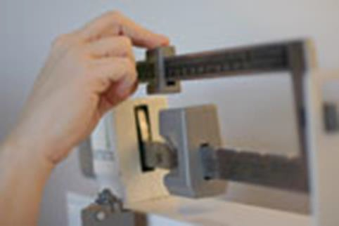
What you can do
Change those risk factors that you can control.
Get to and stay at a healthy weight
throughout life

Slide 37
What you can do
Be physically active
Adults should engage in at least 150 minutes of moderate intensity or 75 minutes of vigorous intensity activity. Being physically active for at least 30 minutes each day decreases your risk.
Limit sedentary behavior
Limit alcohol
Have no more than 1 drink a day for women (2 drinks a day for men)

Slide 38
What you can do
Be as lean as possible
Avoid sugary drinks, processed foods high in fat and low in fiber
Eat more vegetables, fruits, whole grains and legumes
Limit consumption of red meats and limit processed meats

Slide 39
What you can do
Get screened.
If you are age 40 or older, talk to a health care provider about the screening plan that’s best for you.
Also talk with a provider about your cancer risk. Review your medical history and your family history to find out if you need to start testing earlier.

Slide 40
More information
You can get more information about breast cancer on our website, www.cancer.org.
Or call 1-800-227-2345 to talk with one of our Cancer Information Specialists.

Slide 41
Thank you!

