Slide 1
High Blood Pressure
What you need to know
Presented by: Phyllis Schilp RN BSN
Sudbury Board of Health Nurse

Slide 2
What is Blood Pressure?
Blood Pressure is the force of the blood pushing against the walls of arteries.
Blood Pressure is written as two numbers. Systolic/Diastolic numbers.
New Guidelines from JNC gives new BP measurement guidelines.

Slide 3
Blood Pressure
SYSTOLIC
DIASTOLIC
The top or first number of your blood pressure reading.
Systolic pressure is the higher number & measures your heart while it beats (at work).
In Older People the most common form of high blood pressure is systolic pressure elevation.
The bottom or second number of your blood pressure reading.
Diastolic pressure is the lower number & measures your pressure when it relaxes between beats (at rest).

Slide 4
Blood Pressure Categories
CATAGORY | SYSTOLIC | DIASTOLIC
NORMAL | LESS THAN 120 | LESS THAN 80
PRE- HYPERTENSIVE | 120-139 OR | 80-89
HIGH BLOOD PRESSURE STAGE 1 | 140-159 OR | 90-99
HIGH BLOOD PRESSURE STAGE 2 | 160 OR HIGHER OR | 100 OR HIGHER
HYPERTENSIVE CRISIS (EMERGENCY) | HIGHER THAN 180 OR | HIGHER THAN 110

Slide 5
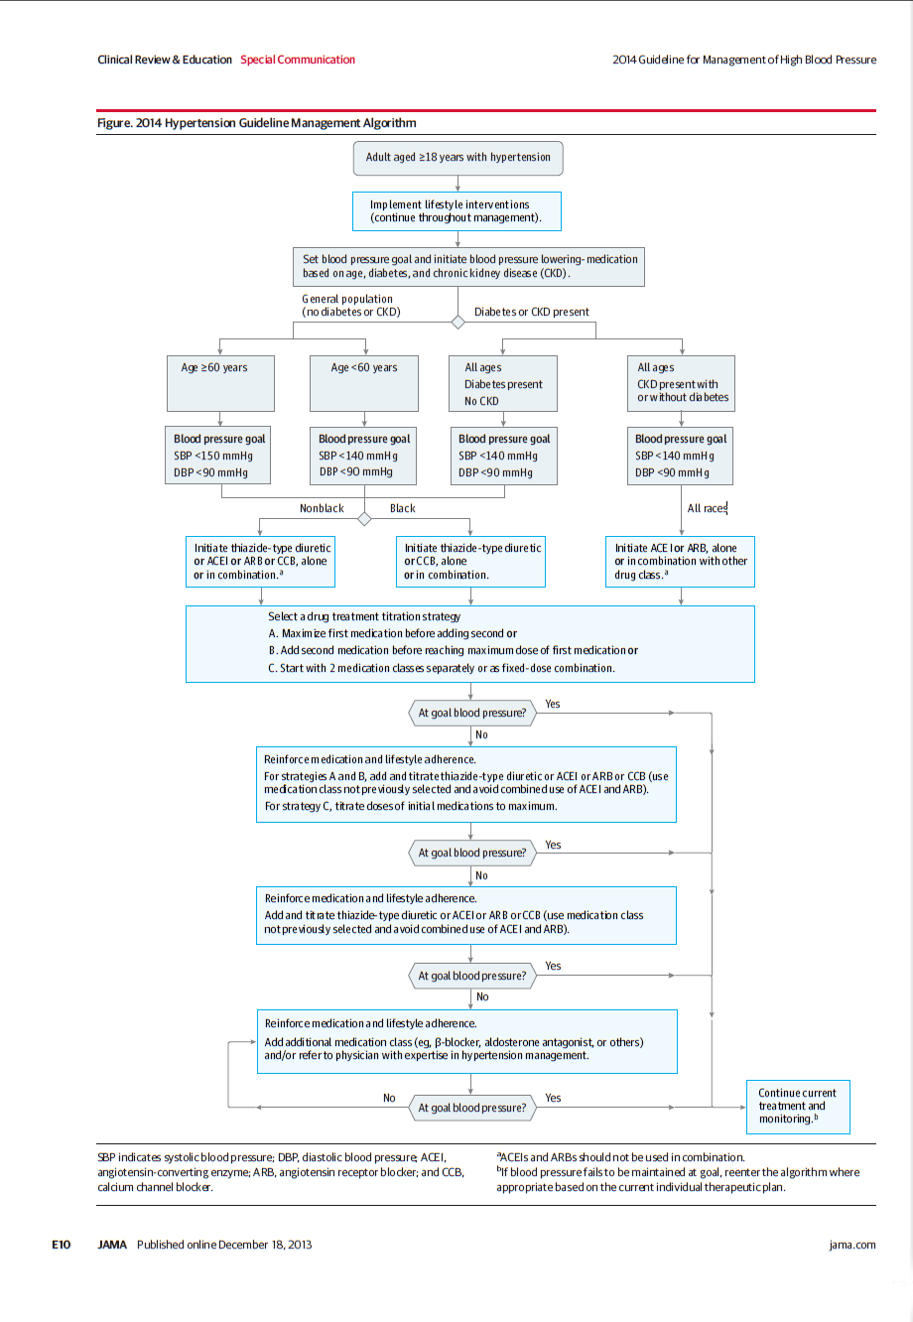

Slide 6
What is Hypertension?
<script language="JavaScript1.2" type="text/javascript" charset="ISO-8859-1" src="http://as.webmd.com/js.ng/Params.richmedia=yes&transactionID=3748521697139&tile=3748521697139&bc=_age122_sex2_sex1_f65_f52_age2_age121_cust1_r05_o8_o15_f33_e1_r52_bty21_h16_f43_f41_diet_food_fit_k590_g00_a080_j10_&xpg=1817&sec=8001|8005|8006|8007|8008&artid=140600&site=2&affiliate=22&uri=subject%3Dhigh%5Fblood%5Fpressure%5Fslideshow%5Fpicturessource%3Dem&pos=101&app=22&dmp=_lall_"></script>
Home
Topics A-Z
Slideshow Pictures
Image Gallery
Medications
Quizzes
Medical Dictionary
About Us | Privacy | Site Map
January 4, 2013
Like Us
home > blood pressure center > blood pressure a-z list > high blood pressure slideshow pictures article
Slideshow Pictures: High Blood Pressure (Hypertension) -- Symptoms, Causes and Treatments
Reviewed by Louise Chang, MD on Tuesday, February 15, 2011
What Is Hypertension?
Hypertension, or high blood pressure, is a common condition that will catch up with most people who live into older age. Blood pressure is the force of blood pressing against the walls of your arteries. When it's too high, it raises the heart's workload and can cause serious damage to the arteries. Over time, uncontrolled high blood pressure increases the risk of heart disease, stroke, and kidney disease.
Previous
1/27
Next
<script language="JavaScript1.2" type="text/javascript" src="http://as.webmd.com/js.ng/Params.richmedia=yes&transactionID=3748521697139&tile=3748521697139&bc=_age122_sex2_sex1_f65_f52_age2_age121_cust1_r05_o8_o15_f33_e1_r52_bty21_h16_f43_f41_diet_food_fit_k590_g00_a080_j10_&xpg=1817&sec=8001|8005|8006|8007|8008&artid=140600&site=2&affiliate=23&uri=subject%3Dhigh%5Fblood%5Fpressure%5Fslideshow%5Fpicturessource%3Dem&pos=121&app=22&dmp=_lall_"></script>
Previous
1/27
Next
Sources:
This tool does not provide medical advice. See additional information:
© 2011 WebMD LLC. All rights reserved.
First Aid & Emergencies | Topics A-Z | Picture Slideshows | Medications | Image Gallery | eTools | Medical Dictionary Definitions
About Us | Privacy | Terms of Use | Advertising Policy | Site Map | Contact Us
WebMD | Medscape Reference | Medscape | MedicineNet | RxList | BootsWebMD
Ad Choices
©2013 WebMD, Inc. All rights reserved.
eMedicineHealth does not provide medical advice, diagnosis or treatment.
See Additional Information.
Hypertension, or high blood pressure, is a common condition that will catch up with most people who live into older age. Hypertension raises the heart's workload and can cause serious damage to the arteries. Over time, uncontrolled high blood pressure increases the risk of heart disease, stroke, and kidney disease.

Slide 7
Hypertension=High Blood Pressure
High Blood Pressure is a pressure of 120/80
It can’t be cured but can be managed
Usually no signs or symptoms
76.4 Million Americans over age 20 have it
Life long disease

Slide 8
Who Gets High Blood Pressure?
Up to the age of 45, more men have high blood pressure than women. It becomes more common for both men and women as they age, and more women have hypertension by the time they reach 65. You have a greater risk if a close family member has high blood pressure or if you are diabetic. About 60% of people with diabetes have high blood pressure.

Slide 9
What can untreated High Blood Pressure lead to?
Stroke
Heart Attack
Angina
Kidney Failure
Peripheral Artery Disease
Blindness

Slide 10
Risk Factors
Age- Increases as you get older
Gender- Men have a higher incidence
Family History- Runs in some families
Smoking
Obesity
Excessive Alcohol consumption
Lack of physical exercises
Diabetes

Slide 11

Hypertension and Sodium
Sodium, a major component of salt, can raise blood pressure by causing the body to retain fluid, which leads to a greater burden on the heart. The American Heart Association recommends eating less than 1,500 milligrams of sodium per day. You'll need to check food labels and menus carefully. Processed foods contribute up to 75% of our sodium intake. Canned soups and lunch meats are prime suspects.

Slide 12
Hypertension and Weight
Being overweight places a strain on your heart and increases your risk of high blood pressure. That is why diets to lower blood pressure are often also designed to control calories. They typically call for cutting fatty foods and added sugars, while increasing fruits, vegetables, lean protein, and fiber. Even losing 10 pounds can make a difference.

Slide 13
Hypertension and Alcohol
Drinking too much alcohol can increase your blood pressure. Guidelines from the American Heart Association state that if you drink alcohol, you should limit the amount to no more than two drinks a day for men, or one a day for women. They define a drink as one 12-ounce beer, four ounces of wine, 1.5 ounces of 80-proof spirits, or one ounce of 100-proof spirits.

Slide 14
Hypertension and Medicine
Cold and flu medicines that contain decongestants are one of several classes of medicine that can cause your blood pressure to rise. Others include NSAID pain relievers, steroids, diet pills, birth control pills, and some antidepressants. If you have high blood pressure, talk to you doctor about what medicines and supplements you are taking that may affect blood pressure.

Slide 15
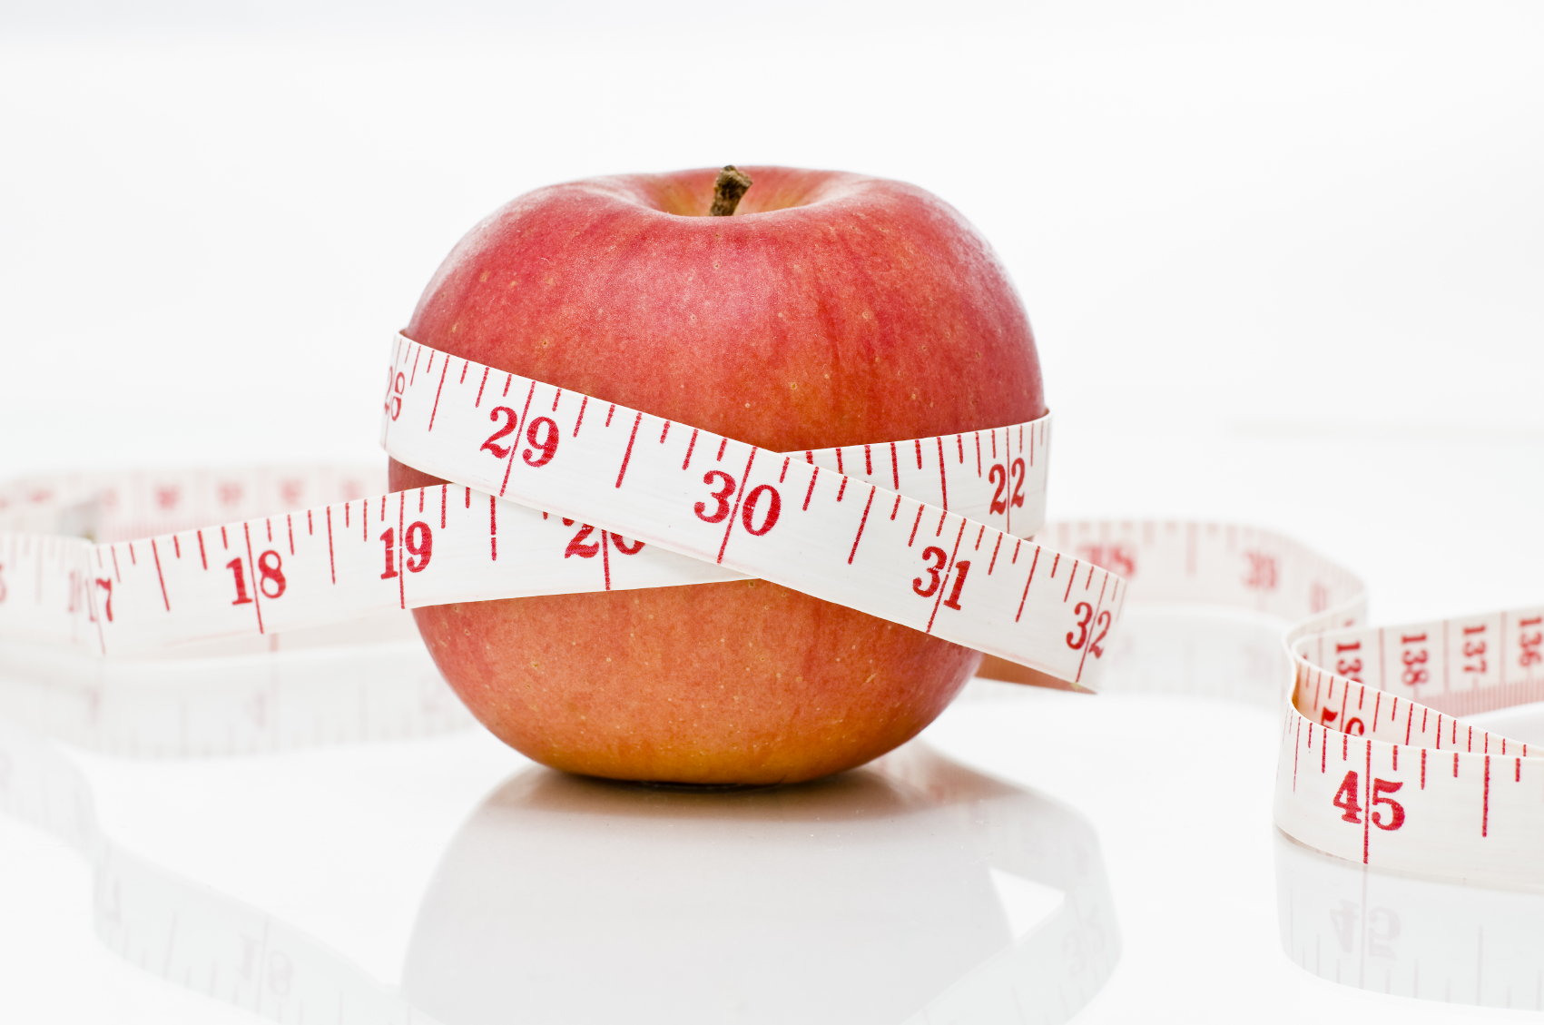
Treatment: The DASH Diet
You may be able to lower your blood pressure by switching to a better diet. The DASH Diet -- Dietary Approaches to Stop Hypertension -- involves eating more fruits, vegetables, whole-grain foods, low-fat dairy, fish, poultry, and nuts. You should eat less red meat, saturated fats, and sweets. Reducing sodium in your diet can also have a significant effect.

Slide 16
Treatment: Exercise
Regular exercise helps lower your blood pressure. Adults should get about 150 minutes of moderate-intensity exercise every week. That could include gardening, walking briskly, bicycling, or other aerobic exercise. Muscle-strengthening activities are recommended at least two days a week and should work all major muscle groups.

Slide 17
Living With High Blood Pressure
Hypertension is often a life-long condition. It's important to take your medications and continue to monitor your blood pressure. If you keep it under control, you can reduce your risk of stroke, heart disease, and kidney failure.

Slide 18
How to Improve Blood Pressure
Modification | Recommendation | Approximate SBP Reduction Range
Weight reduction | Maintain normal body weight | 5-20 mmHg 10 kg loss
DASH eating plan | Diet rich in fruits, veggies, low fat diary and reduced in fat | 8-14 mmHg
Restrict Sodium Intake | < 2.4 grams of sodium per day | 2-8 mmHg
Physical Activity | 30 minutes of aerobic exercise | 4-10 mmHg
Moderate alcohol | 2 drinks/day for men 1 drink/day for women | 2-4 mmHg

Slide 19
ABCD’s of BP Measurement
Achieve a calm state
Make sure you are quiet and relaxed
Sit calmly without talking for 5 minutes
Avoid caffeine, alcohol, and smoking
Body posture is important
Sit in a chair with feet flat on floor
Legs should not be crossed
Arms should be bare and at heart level

Slide 20
ABC’s of BP Management cont.
Calibrate & check equipment
Use a properly calibrated and validated instrument
Check the cuff size and fit
Double check any high readings
If BP registers high, take two readings 5 minutes apart
Confirm any elevated readings in opposite arm

Slide 21
Resources
  American Heart Association, 2012, Hypertension, http://www.heart.org/HEARTORG/Conditions/HighBloodPressure/High-Blood-Pressure-or-Hypertension_UCM_002020_SubHomePage.jsp
  National Heart Lung and Blood Institute, 2012, Hypertension, http://www.nhlbi.nih.gov/health/public/heart/index.htm#hbp
  WebMD, 2012, Hypertension, http://www.webmd.com/hypertension-high-blood-pressure/ss/slideshow-hypertension-overview

