Slide 1
Fairbanks Community Center Study Task Force
Status Update April 14, 2016

Slide 2
Welcome, Introductions & Agenda
Forum Objectives
Task Force Mission & Guidance
Summary of Work to Date
Report Conclusions & Overview of Next Steps
bh+a Recommendations & Evolution of Conceptual Designs
Task Force Recommendations
Town Meeting
Taxes and Financing
Conclusion

Slide 3
Objectives of the Forum
Provide update on the status of the project
Prepare for May Town Meeting
Seeking support of Article 33
$1.2MM in Design Funds for a new Community Center
Answer your questions and hear your feedback

Slide 4
Task Force Mission & Guidance
Abridged mission statement from 2012
“advise the Board of Selectmen as to the best options for dealing with the failing roof on the non-Pool section of the Fairbank Community Center”
“provide an assessment of the capacity of the existing building to meet the current and future program and office needs and goals”
Overall Guidance from Town Manager:
Work to minimize the town annual subsidy while still providing the appropriate services.
Continue to provide suitable Emergency Shelter Services

Slide 5
Some Terms Used throughout Presentation
Town Subsidy– If needed the annual amount the town will have to contribute via the annual budget to operating expense recovery
Construction Costs– Direct payments made to building contractors who are physically creating the building.
“Soft Costs”- Those other costs of managing the project including fees, document control expenses, internal furniture, and the town’s expenses to oversee the project.
“Project” Costs- Total cost of the project including Construction and “Soft”
Dislocation– The tasks associated with all tenants having to work around construction including deferral or cancelation of many programs if needed.
Cost Neutral--- A program or programs is “cost or revenue neutral” if operating expenses are exactly offset by fees or other revenue

Slide 6
Summary of Work Completed Since 2012
Initial investment of $91K ($36K town funded, $55K privately funded)
Feasibility Study led by Bargmann, Hendrie + Archetype (BH+A) resulting in Comprehensive 175 page feasibility analysis
A 2012 report by engineering consultant Russo Barr
Reports by engineering consultant Simpson, Gumpertz & Heger in 2013
Revenue/Expenses report from Ballard King
Meetings with:
Senior Center, Council On Aging, Friends Of The Sudbury Senior Center
Park & Recreation, Recreation Commission, Sudbury Aquatics, L-S Swimming, Teen Center
Sudbury Public Schools, Sudbury Family Network, Town Staff, Police Chief, Fire Chief, DPW, Health Department, FinComm, CIAC, PBC, and more
Input from the residents at large, including public forums on
February 27, 2014
March 26, 2015
Today! April 14, 2016

Slide 7
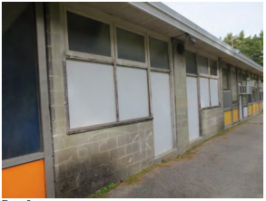
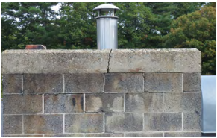
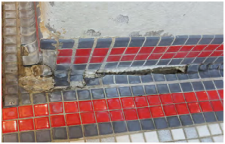
Study Conclusion: Multiple Structural Deficiencies Found
From the bh+a Report: “The roof structure requires significant reinforcement to its framing and roof deck to meet current code requirements… masonry walls are not reinforced and require reconstruction, replacement, or supplemental framing to meet lateral and seismic loading requirements…
…In simple terms, installation of sprinkler piping, ductwork, HVAC equipment, or new roof insulation would require new structural framing to reinforce the roof and walls.”
Notes:
Jim Kelly to speak

Slide 8
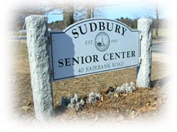
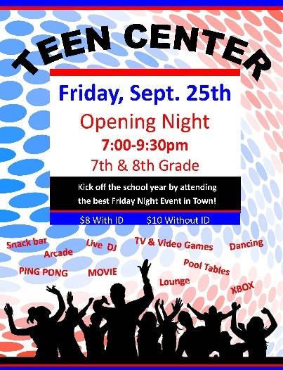
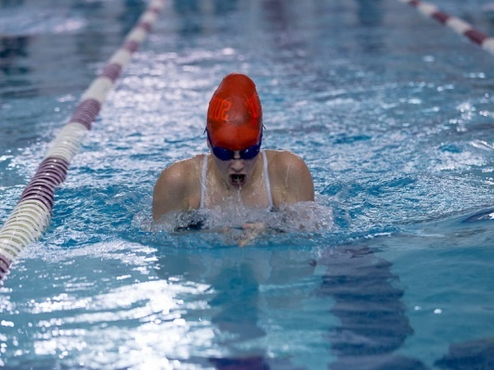
Study Conclusion: Program Needs Not Met
Existing 40,000 (33K without SPS) square foot building does not meet current or future program needs.
needs

Slide 9
A Word From Debra Galloway, Director of Sudbury Senior Center

Slide 10
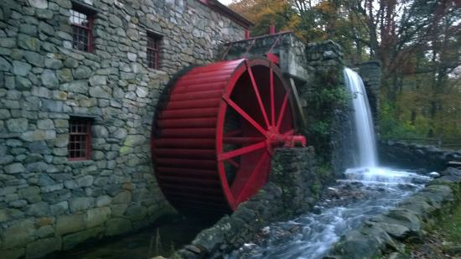
Strengthening Sudbury
Beautiful town, Rich history, Great People
Our Older Residents Have Provided Decades of Service, and Counting…
Creating and Maintaining an Family and Age Friendly Community
Notes:
Sudbury is a beautiful town, we have a rich history. People that live here are involved and contributors.
Part of that history, strength of the town - are the residents who have lived here for 30, 40, 50 or 60 years.
When they were younger they volunteered to coach Little League, be Scout leaders, work with the PTO, as they moved into middle age many became involved in Town or Community groups: Garden Club, Permanent Building committee, Planning Board, HopeSudbury, Friends of the Library, and more, and many of these people continue to serve either on a Town committee, community group or at the Senior Center.
We have been fortunate to have many of them become our volunteers.
about 300 active volunteers that we will invite to our annual Volunteer luncheon this year – they help in 34 different areas of Senior Center programming. There are also about 80 people who volunteer for the Bridges intergen’l program connecting older adults and 4th graders
This has been and will continue to be one of Sudbury’s strengths. One of the things that makes Sudbury an Age and Family Friendly community.
IN thinking about an age friendly community, I remember the history of the Senior Center: Sudbury residents worked to create an age-friendly community – they advocating for a designated Senior Center which resulted in the addition to the Fairbank building in 1990, which is the current Senior Center. Beginnings of age friendly community started then – and continue to grow with network of services, programs and the people who participate. However, there is more that can and needs to be done.
*Part of the reason for this is…
They continue to sustain a network that provides support for their neighbors. They advocate for themselves, their neighbors. We hear from them and hope to continue to advocate for their and the growing populations needs. But there is more that can and needs to be done.

Slide 11
Sudbury’s Population is Changing
In the United States, Massachusetts and Sudbury
Change is happening because:
Baby boomers are aging, 10,000 turning 65 every day now (source: Pew Research)
We are living longer
Sudbury’s seniors would like to “age in place”
Sudbury has added age- restricted housing over the last several years, and there’s more to come
Notes:
As you may have heard, we are experiencing a Demographic change in America. The large group of Baby Boomers is aging. 10,000 boomers are turning 65 every day according to Pew Research.
And we are living longer, Americans gained 30 years of life expectancy in the 20th century (Washington Post)
And within Sudbury, people are looking to age in place, if possible. Staying in the community they know, where they have made connections.
Lastly, Sudbury has added some targeted housing to the 55+ crowd, including: Springhouse pond, Frost Farm, Mahoney Farms, Grouse Hill, North Woods, and Coolidge at Sudbury. We already had Longfellow Glen and Musketahquid Village. And now a 55+ development at the Raytheon Property and possibly at Town Center.

Slide 12
Growth of 60+ Population - Sudbury
By the Numbers
Growth of 60+ Adult Population in Sudbury
By Percentage
60+ Adults as Percentage Total Sudbury Population
14%
Notes:
Here’s an projection of Sudbury’s 60 and over population over the next 25 years
Projections are based on information from the BayPath Elder Services 2014-2017 Area Plan;
about 1/3 of the population of Sudbury will be 60 and older in 2040

Slide 13
Why the Senior Center is Important
Life Changes…
You may need help with an aging parent or spouse while they are recuperating from surgery or illness
You may need help with Medicare, legal questions, downsizing, planning
When you get older, you may need ways to continue to be productive, have meaning, have connection
You want to have continue learning and growing and have fun!
You may need help with transportation
You may need support as you deal with the loss of a loved one

Slide 14
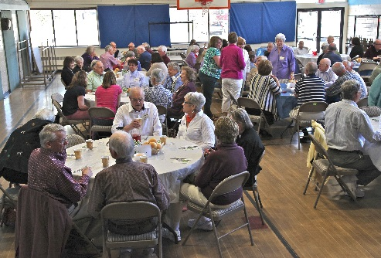
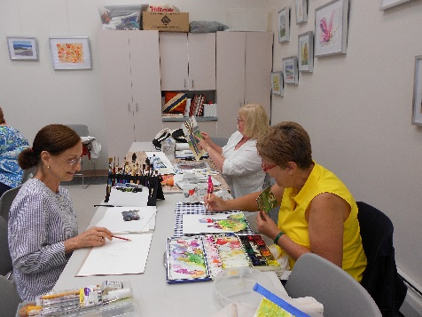
Senior Center Participation
Numbers
Programs/Services
1,600 different individuals participate each year
We help 200 people under 60 who need help with a parent
We help 20 individuals who have a disability
Approximately 34,000 visits or services each year
300 volunteers
Lifelong learning classes: history, art, science
Fitness classes: Fit for the Future, Yoga, Tai Chi, Tap Dance, Better Bones
Healthy aging programming
Individual and Group Support
Information/Assistance for seniors and caregivers
Rides to employment, doctors, and shopping
Notes:
Already the Senior Center has excellent participation; and we are having difficulty fitting in all of the programming that we would like to offer. This list is just a few of the types of programs and services we provide on a regular basis.
Also provide in-home fixit friendly visitor shopping assistance sand buckets
(PHOTOS: Volunteer luncheon Watercolors workshop.)

Slide 15
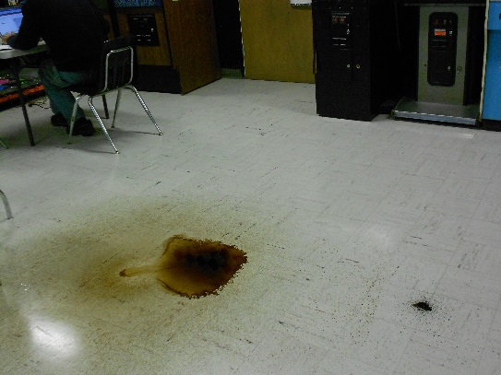
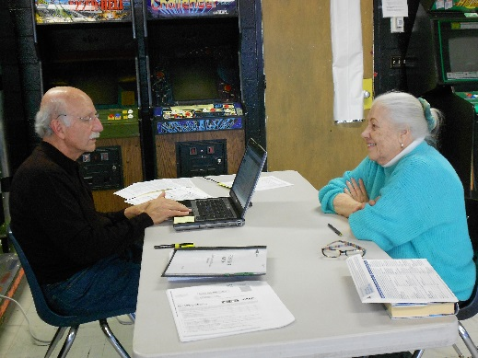
Senior Center Space Issues
Building is old, leaking from old roof made some rooms unusable in winter, or during heavy rains; pipes have started to burst
Fitness and other programs are sometimes cancelled, often moved to rooms that are not appropriate, sometimes moved off site
Each election closes the gym for a few days and cause cancelled or programs in inappropriate space
Not enough space for consultations and counseling – need to move staff out of their offices, can’t offer some programs at all
Notes:
Fitness classes get moved around a lot; sometimes we have to cancel; have worked hard to schedule them in different rooms (but most are smaller and not appropriate), or to schedule them offsite at church function rooms
(this is an option we have used, but it is not ideal, it can be difficult to people to find the new location, or we may find the location is not appropriate due to lack of access to a phone.
Meetings on programs often need to be held in rooms that are set up for arts and crafts or Teen Center.
Elections can close down the gym for several days.
We need private consultation space for information/referral, Medicare counseling, legal counseling, meeting with the nurse (bp, diabetes, health counseling

Slide 16
Council on Aging Comments Regarding Concept Plans
The Council on Aging supports a plan to meet the growth needs of older adults
Recognizes the ongoing contributions of the older residents of Sudbury
Has seen the senior population more than double since the Senior Center addition was built in 1990, and knows it will continue to grow for 35 more years (60+ population was about 1,200 residents in 1990, now 60+ population is about 3,800 residents)
Benefits of a new Community Center:
Based on need/future population trends
Updates a deteriorating building
Supports need for additional space for programming
Supports need for increased diversity of programs, including more healthy aging, intergenerational programs
Supports Sudbury’s goal to be age and family friendly into the future
Notes:
The Council on Aging seeks a plan for the Community Center that will provide space and opportunities for seniors to meet their social, recreational, educational and health needs.
The COA hopes to that this can be in a multi-generational space where neighbors and families can meet each other.
And the COA is looking to the plan to offer enough space and flexibility to meet the needs of the Sudbury population for the next 30-40 years.

Slide 17
Strengthening Sudbury
Beautiful town, Rich history, Great People
Our Older Residents Have Provided Decades of Service, and Counting…
Creating and Maintaining an Family and Age Friendly Community
Notes:
Sudbury is a beautiful town, we have a rich history. People that live here are involved and contributors.
Part of that history, strength of the town - are the residents who have lived here for 30, 40, 50 or 60 years.
When they were younger they volunteered to coach Little League, be Scout leaders, work with the PTO, as they moved into middle age many became involved in Town or Community groups: Garden Club, Permanent Building committee, Planning Board, HopeSudbury, Friends of the Library, and more, and many of these people continue to serve either on a Town committee, community group or at the Senior Center.
We have been fortunate to have many of them become our volunteers.
about 300 active volunteers that we will invite to our annual Volunteer luncheon this year – they help in 34 different areas of Senior Center programming. There are also about 80 people who volunteer for the Bridges intergen’l program connecting older adults and 4th graders
This has been and will continue to be one of Sudbury’s strengths. One of the things that makes Sudbury an Age and Family Friendly community.
IN thinking about an age friendly community, I remember the history of the Senior Center: Sudbury residents worked to create an age-friendly community – they advocating for a designated Senior Center which resulted in the addition to the Fairbank building in 1990, which is the current Senior Center. Beginnings of age friendly community started then – and continue to grow with network of services, programs and the people who participate. However, there is more that can and needs to be done.
*Part of the reason for this is…
They continue to sustain a network that provides support for their neighbors. They advocate for themselves, their neighbors. We hear from them and hope to continue to advocate for their and the growing populations needs. But there is more that can and needs to be done.

Slide 18
A Word From Kayla McNamara, Director of Parks, Recreation & Aquatics

Slide 19
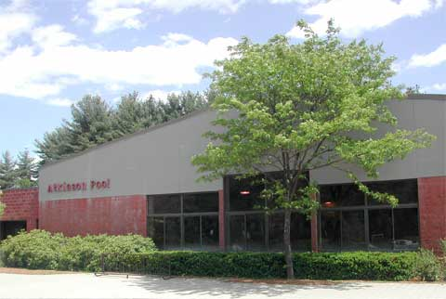
Sudbury Park and Recreation / Atkinson Pool
Community Center established in 1983 in the old school building.
Atkinson Pool was built in 1987.
Currently over 72,000 individuals utilize the pool in a given year.
Over 691 programs offered to over 9,700 participants
Day camp programs sell out in under 10 minutes each year. No opportunity for growth due to building constraints. 40-50 kids on wait list each week.
Only Nationally Certified Park and Recreation Department in Massachusetts, the 2nd in New England and the 118th in the country.

Slide 20
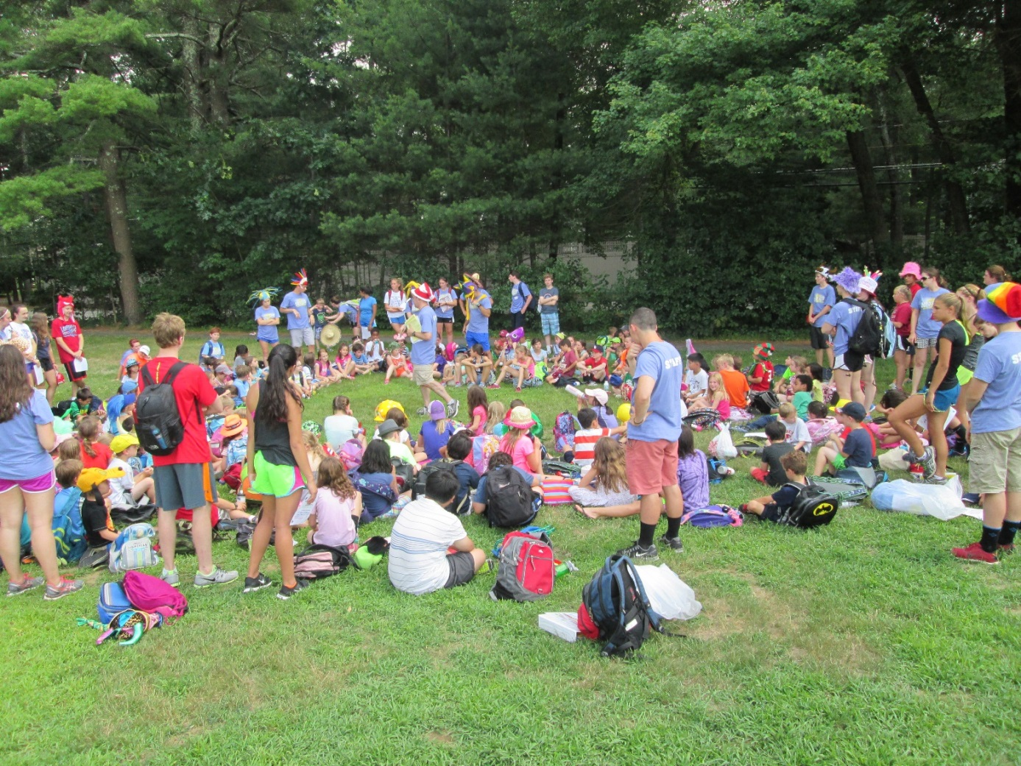
Parks and Recreation
Year round programs
Ages 18 months – senior citizen
Passive classes such as art and lego engineering
Active classes such as sports and line dancing
Self directed recreation such as snowshoe and pickleball
Oversee ballfields, playgrounds, basketball court, volleyball court, 2 outdoor ice rinks, tennis courts, walking paths, outdoor fitness equipment, Heritage Park, Willis Pond, etc.

Slide 21
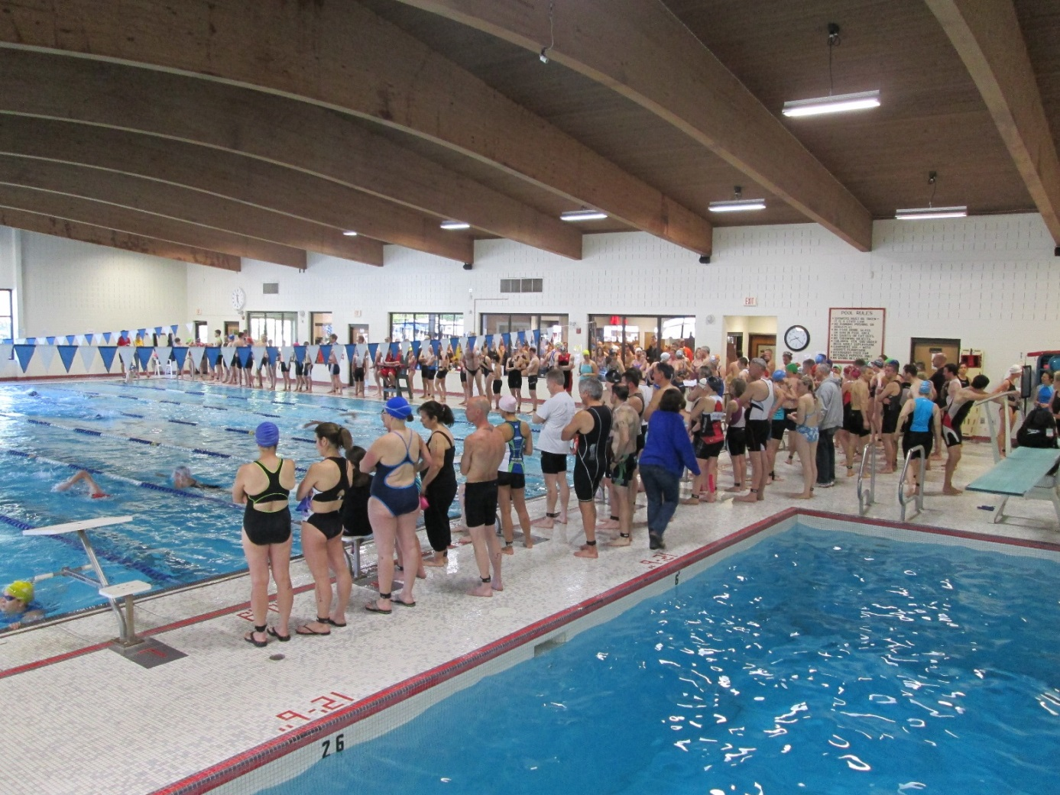
Atkinson Pool
Learn to swim programs
Diving programs
Swim teams
Scuba programs
Triathlon programs
Summer camps
Birthday parties
Lap swim
Family swim
Lifeguard training

Slide 22
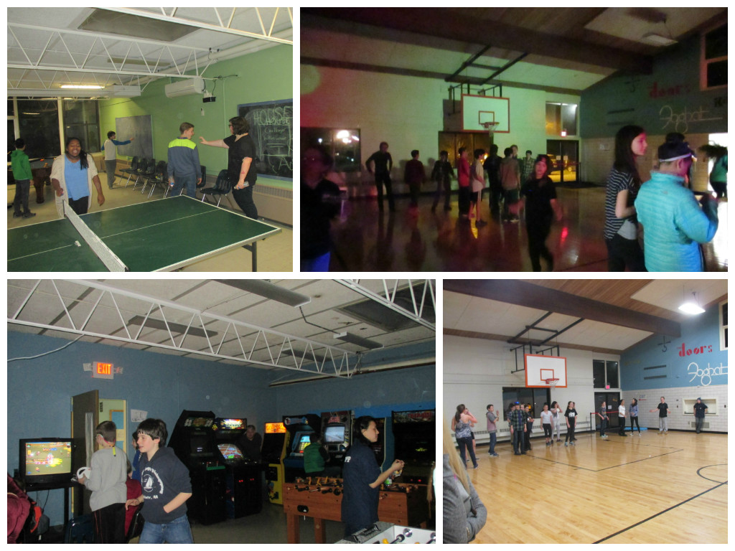
Special Events
Summer concerts
Teen Centers
Drop in Gyms
Youth Triathlons
Halloween 5K
Family Fun Day
Do you want to build a snowman?
Just to name a few…….

Slide 23
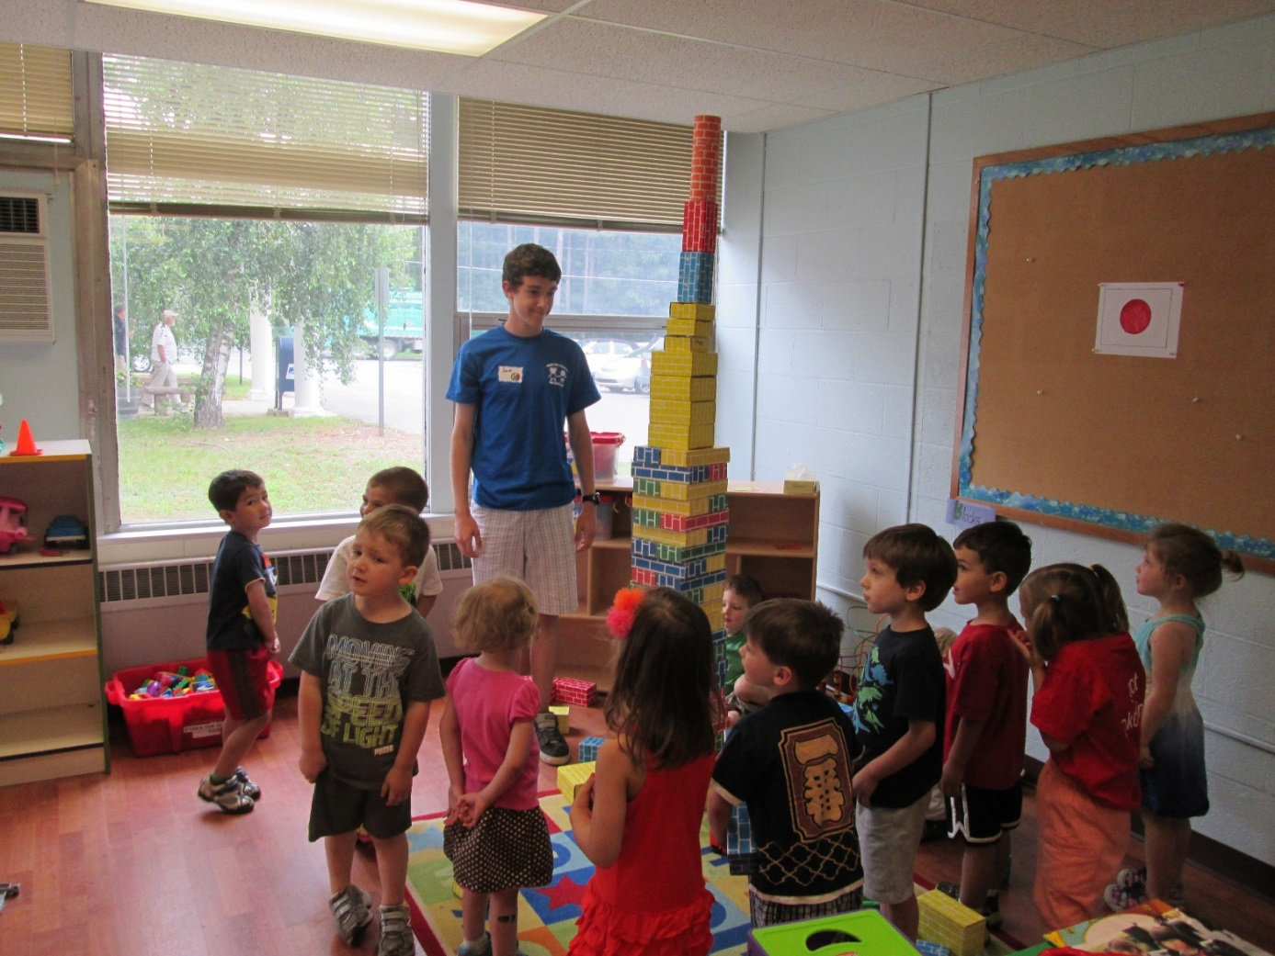
Why a new community center?
Space is too crowded, programs can’t grow
COA needs more room, often we need same spaces at the same time.
Summer time programs need room to expand
No dedicated art space
No dedicated technology space
No dedicated adaptive space
Elections close gym for 4 days, loss of programming time and revenue
Space is too crowded, programs can’t grow. COA needs more room, too many times we need same spaces at the same time.
Summer time programs need room to expand.
No dedicated art space.
No dedicated technology space, yet need for technology programs.
No dedicated adaptive space, growing adaptive programming needs.
During elections lose our only gym space and 1/3 of our room space for 4 days, loss of programming time and revenue.

Slide 24
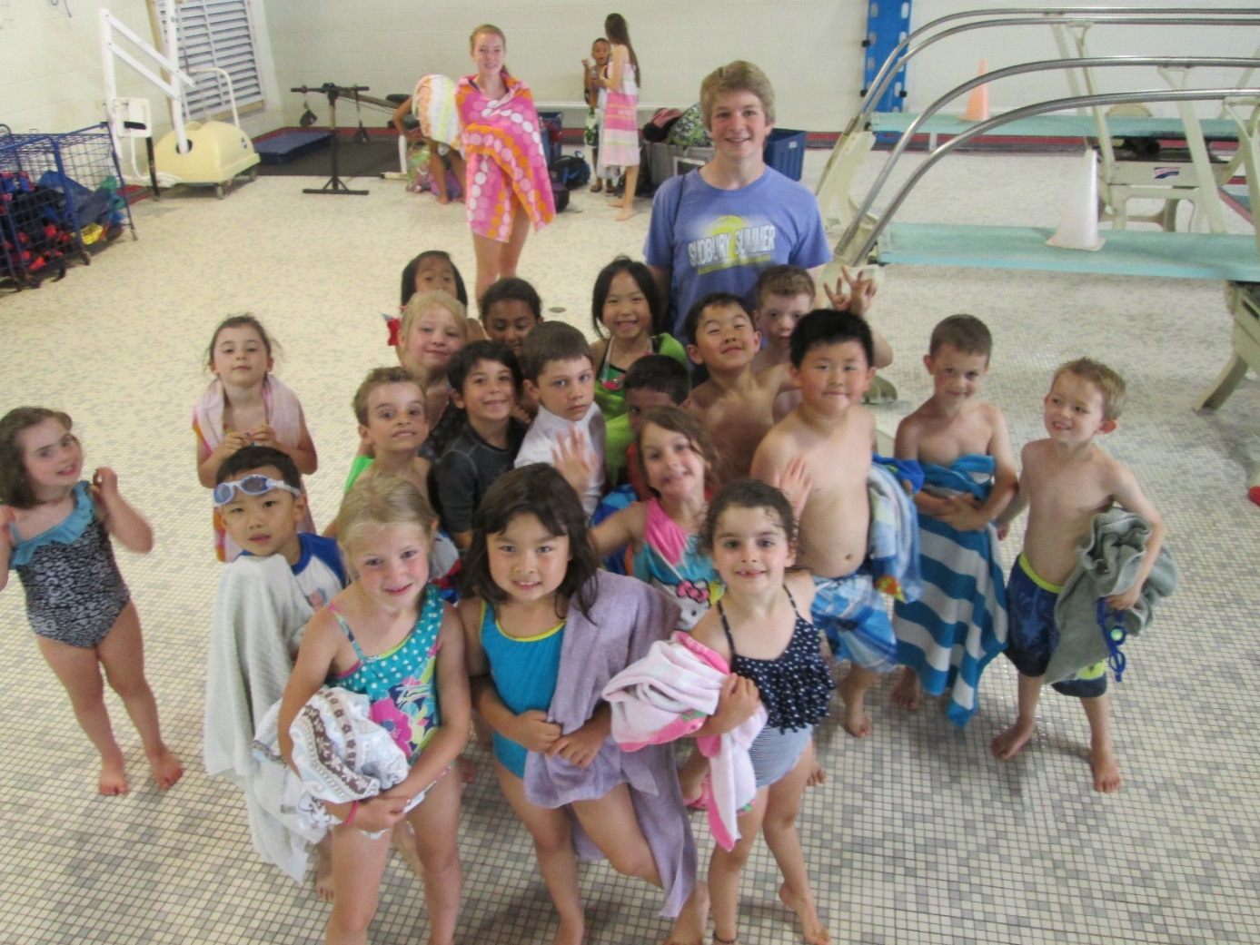
Why a new community center?
Locker rooms are old and barely meet ADA accessibility.
Need family changing room options for both ADA access and for families with small children.
Need team locker rooms that could then be utilized by our camp programs in the summer to keep them separate from the patrons in the regular locker rooms.
Building desperately needs upgrades to heating and roofing. Currently experienced severe leaks this winter making some rooms inoperable for weeks at a time.
Locker rooms are not ADA accessible
Need ADA accessible family changing room
Need team locker rooms for camp programs
Building needs upgrades to heating and roofing. Severe leaks this winter made some rooms inoperable for weeks

Slide 25
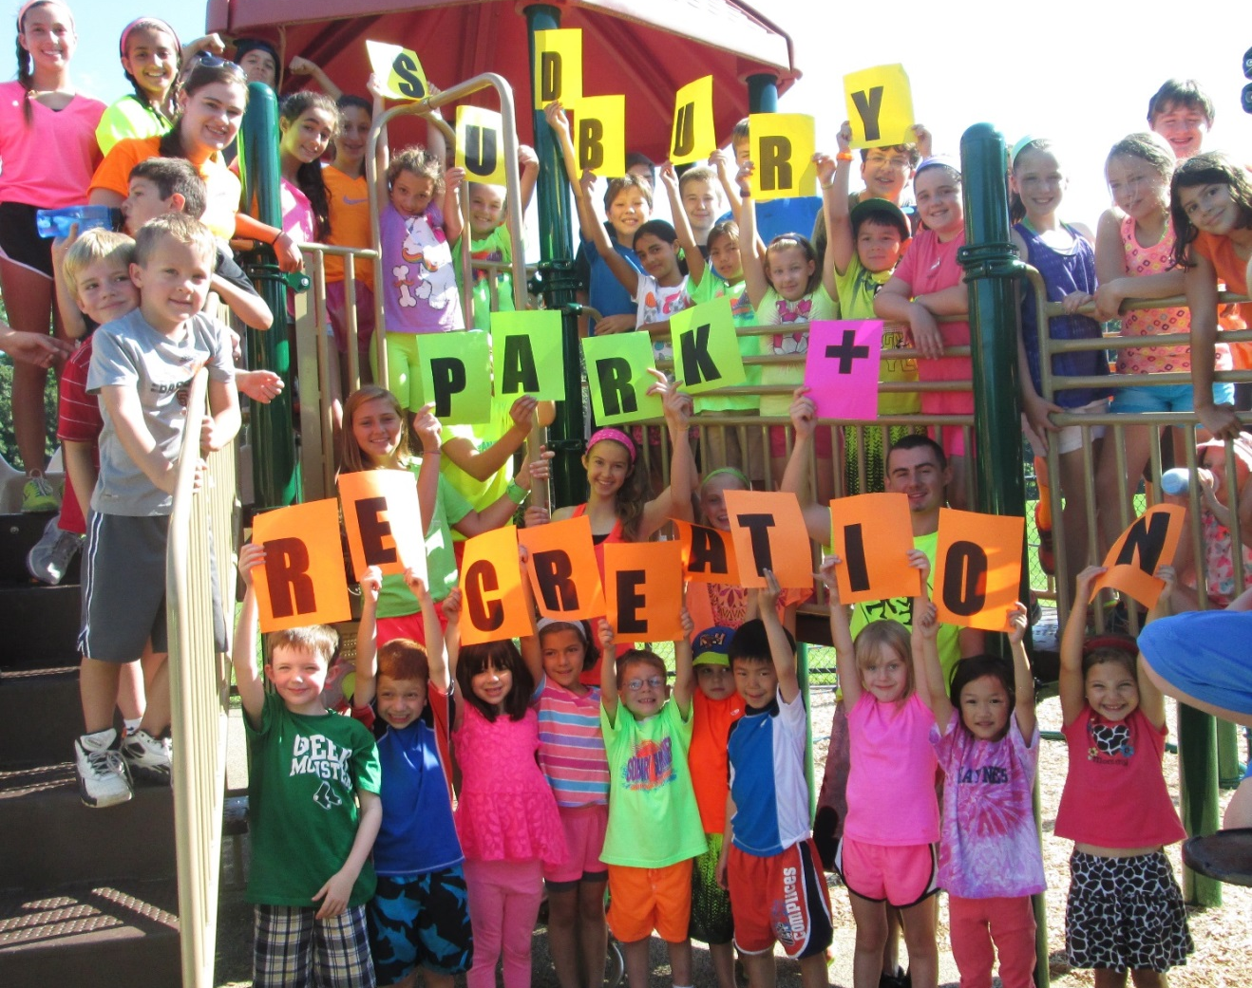
Why a new community center?
Without upgrades to space, and new space program offerings are limited will be limited in our program offerings.
Need a solution for a building that is aging rapidly before it is completely dysfunctional.
A new facility we enable expansion of current program offerings, update the facility to make it compliant and in better condition for our users and bring new programs to the residents of Sudbury.
Limited in our program offerings
Building is aging rapidly
New facility enables expansion of current program offerings
Updating the facility makes it compliant, improves condition and brings new programs

Slide 26
bh+a Study: Overview of Next Steps
“Do Nothing” - Make no repairs until the building is uninhabitable
“Do the Minimum” - Minimum repairs to maintain the building and its use as currently configured ($12MM over 10 years)
Repairs to include: complete structural roof replacement, structural wall replacement, sprinkler installation, code compliant fire alarm system, plumbing repairs, locker room repairs, ductwork, HVAC, and more
BUT, after 10 years, we will only have:
same building and same configuration
This will NOT meet existing Senior Center and Park & Rec needs, let alone future needs.
Periodic disruptions could be significant
Build a new Community Center (Project Cost range of $23MM-$35MM)

Slide 27
Building a New Community Center: Conceptual Design Option 3
bh+a recommends and the Task Force agrees that the optimal next step for Sudbury is to build a new center.
Option 3 - of the three conceptual designs initially shared, Option 3 best meets current and some future program needs
60,000 square feet
One building with multiple users – a multigenerational center
Shared, flexible multi-use spaces
Locker room expansion and upgrade
Addition of a Warm Therapy pool
Notes:
ONLY renovates and repairs existing 8-lane pool.
No change to current diving pool

Slide 28
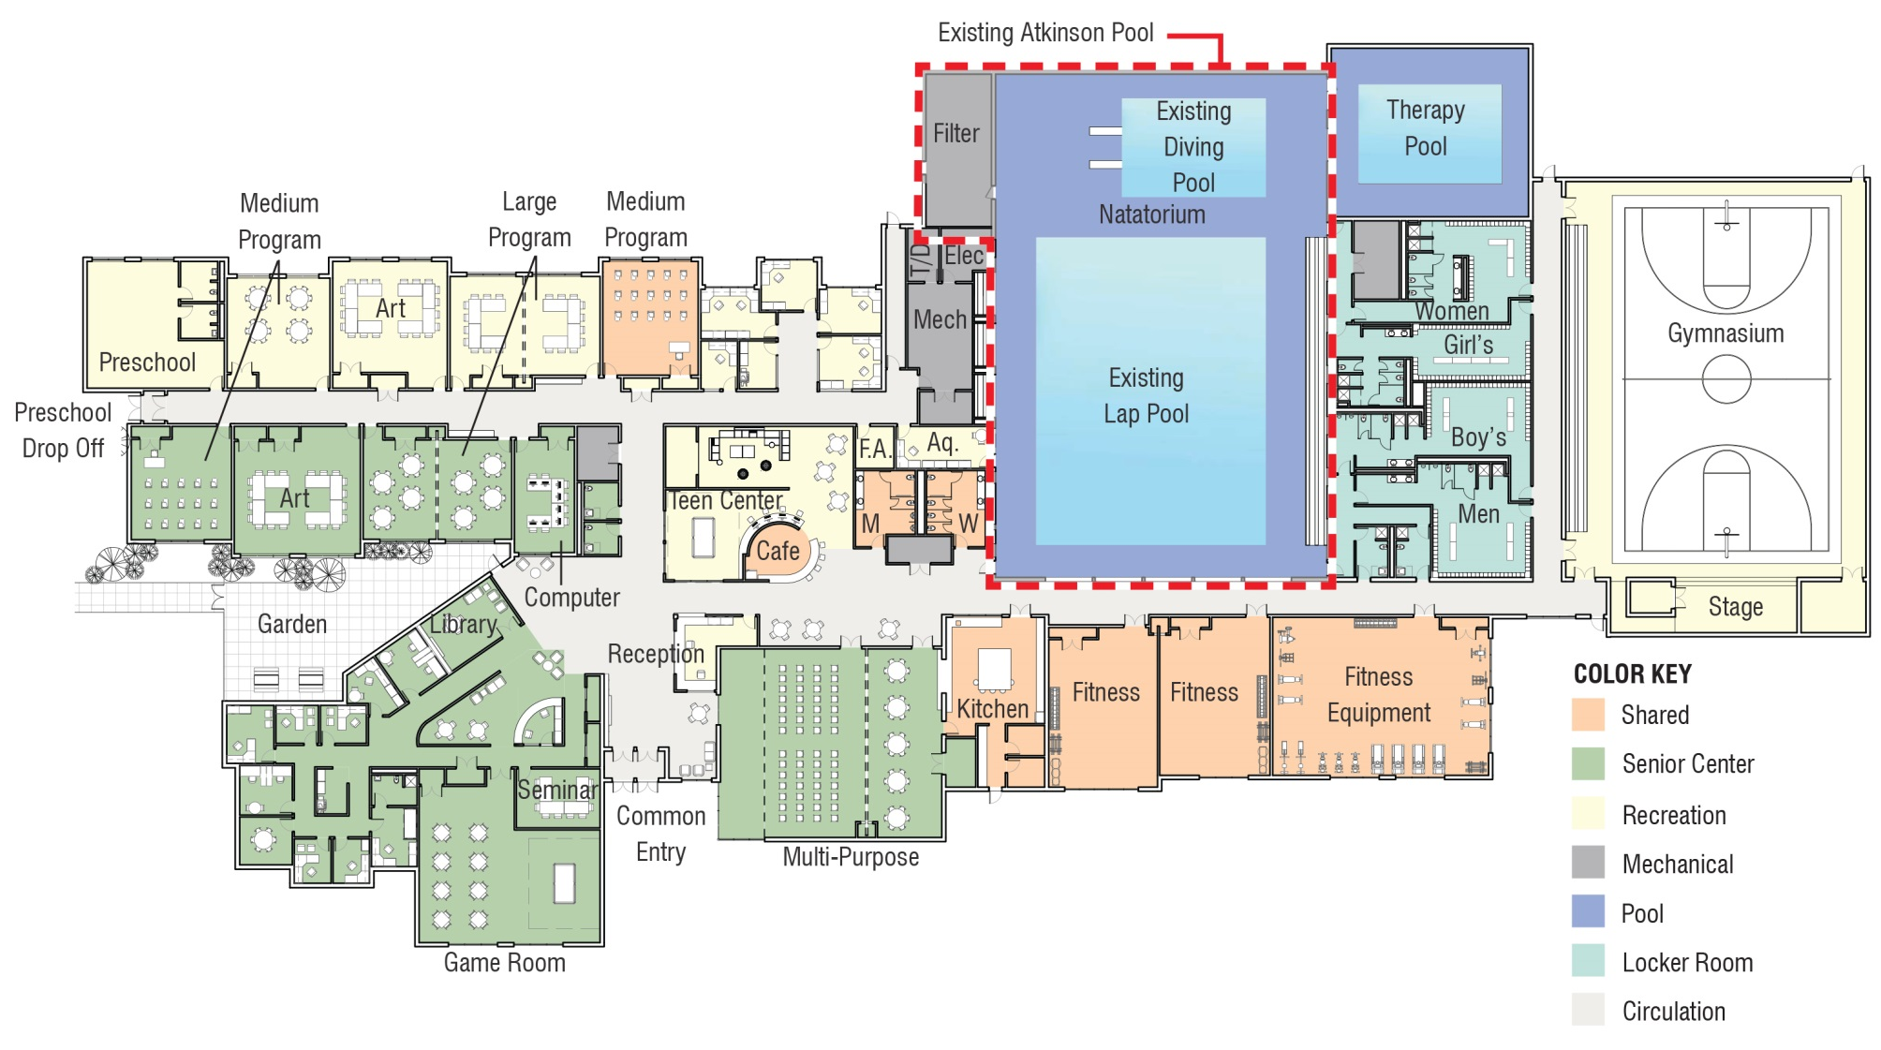
Option 3 – 60,000 Square Feet

Slide 29
Option 3 Cost
Project Cost
Item | Amount
Construction Cost (including escalation) | $18.7MM
Soft Costs (Fees, contingencies, internal furniture and fixtures, etc.) | $4.1MM
Total Project Cost: | $22.8MM
Source: bh+a Feasibility Study and Aedulus

Slide 30
Conceptual Design Evolution
After additional discussions, input from the new Park & Rec Director and public feedback, the Task Force considered additional programs and features:
Option 3 may not adequately address dislocation problems
Site plan was modified to build out towards Hudson Road (South end)
A two story facility
Could accommodate SPS administration.
Allows for desired feature of a walking/jogging track over the gym
Enables spectator seating for swim meets
An expanded preschool space to meet current demand

Slide 31
Continued Evolution
Aquatics:
A larger second “family” warmer water pool could benefit seniors and families (would replace warm therapy pool)
The lap pool and its enclosure are to be new
Diving pool upgraded to meet broader range of competition requirements
A double-court gym:
Allows for growth of high demand Park & Rec children programs which currently sell out within minutes and have large waiting lists
Allows for introduction of new Park & Rec programs such as adult basketball leagues and more
Improved Emergency Shelter
Provide better space for large functions, events and games

Slide 32
A New Conceptual Design: Option 4
Increases the size of Option 3 by about 15% to 69,000 sq. ft.
Is two stories and has a smaller footprint
Aids in eliminating the two year dislocation problem for non-aquatic activities
Allows for new features that create opportunity to minimize the town’s annual subsidies (double court gym & track, pre-school, enhanced aquatics)
Space for SPS can be added increasing total sq. footage to 78,000 sq. ft.
Town is still evaluating SPS alternatives such as leasing and Nixon addition
Including SPS in new building will increase the overall project cost by $3.75MM, however, this alternative would be a minimum of $1.75MM less expensive than a Nixon addition based on current estimates

Slide 34
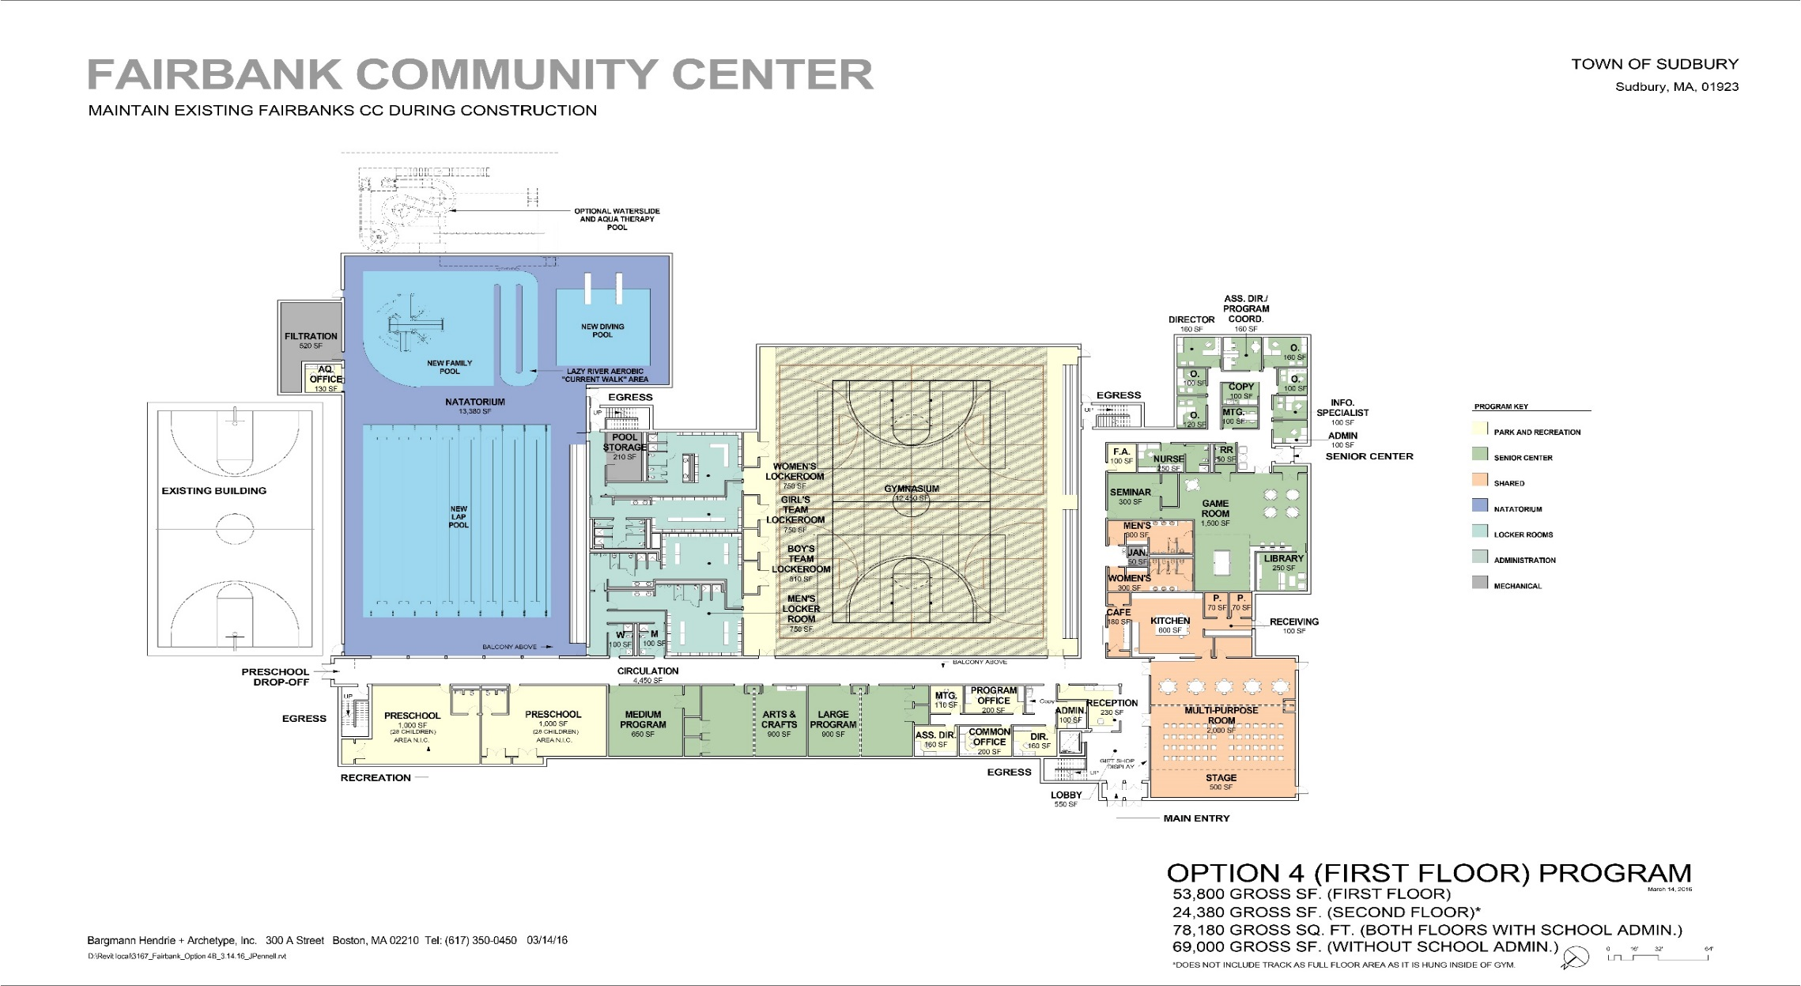
Option 4 – First Floor

Slide 35
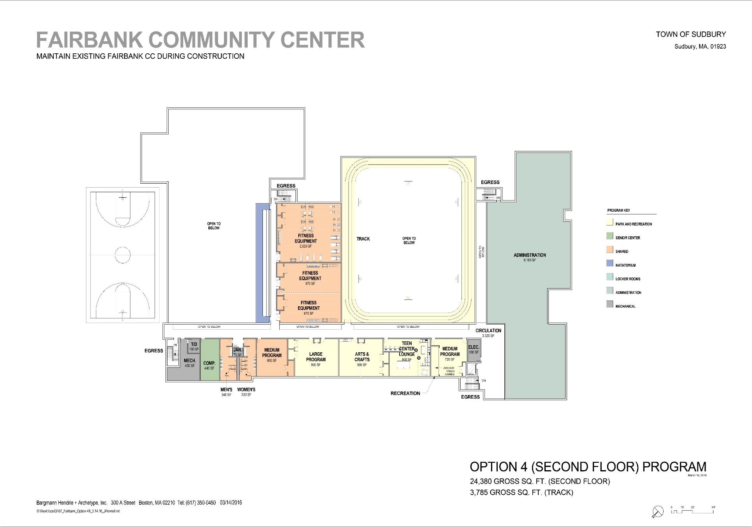
Option 4 – Second Floor

Slide 36
Option 4 Costs
Project Cost Estimate
Item | Amount
Construction Cost (including escalation) | $29.5MM
Soft Cost (Fees, contingencies, internal furniture, fitness equipment and fixtures, etc.) | $5MM
Total Project Cost: | $34.5-35MM
Note this total includes an estimated $3.75MM in incremental project cost associated with 9K square feet for SPS
Source: bh+a second study and Aedulus

Slide 37
Option 4 Costs
Operating Cost Estimate
Category | Existing Facility | Option 4 Additional Facility | OPTION 4 TOTAL FACILITY | Difference
Expenses | $1.65MM | $1.62MM | $3.28MM | 98%
Revenues | $1.28MM | $1.68MM | $2.97MM | 132%
Difference | ($376K) | ~$9K | ($317K) | -16%
Recovery % | 77% | 104% | 90%
Note: This estimate is for the 69K square foot facility without SPS and its correlating operating expenses. It also does not include a stabilization fund for capital repairs.
Source: Ballard King and Aedulus???

Slide 38
Task Force Recommendations
Seek Design Funding at Town Meeting in order to:
Pursue Option 3 with further consideration of features from Option 4
Inclusion of SPS
A two-story design that permits south side development (avoids displacement)
Deeper analysis of revenue opportunities (camps, pre-school, fitness, fees for non-residents, etc.)
Further evaluation of aquatics (Family Pool vs. Warm Therapy Pool, enhanced Diving Well)
Improvements of Emergency Shelter services

Slide 39
Town Meeting Article 33
Article 33 seeks $1.2MM for designing a new Community Center
The basis for the design is a 60,000 square foot building, AKA Option 3, which represents the minimum size required to provide residents the services requested
Deliverables to include:
Schematic Design
Design & Development Documents
This Design phase will determine final building option
Critical component of this next step is to more concretely define and further analyze the Operating Plans (revenue/expenses)
Integrated participation of Town Staff in this process is essential
Public Forums will continue during this phase to seek resident input

Slide 40
Property Tax Estimates & Financing
Financing Scenario for Project Costs: $30MM debt exclusion over 25 years
Tax increase would peak in 2020 at $365 for average household, then reducing annually for another 21 years
Financing Scenario for Design Funds: $1.2MM bond over 5 years
Tax increase would be approximately $36 per year for the average household
Current estimates are for 100% town funding, however, the Task Force recommends:
Exploration of private funding, applications for Senior related grants, CPC funds, etc.
Creation of sub-group to analyze in detail over next 9-10 months
Note: The Task Force set its own internal maximum at $500 per household for both Capital and town annual budget subsidies.
The Option 4 estimates are currently BELOW this target. More work needed in the next 9-10 months.

Slide 41
Brief Project Time Line
Feasibility Study & Conceptual Designs (this phase is completed)
May 2016: Seek approval of 50% of Design fees (to be funded via Article 33)
Schematic Design , Design & Development
May 2017: Seek approval for final 50% of Design, Construction Documents, Bidding and Construction
Summer and Fall 2017: Completion of Remaining Design - Bidding Process - End of Year 2017
Spring 2018: Commence Construction (pending approval of bids)
2020: Occupancy Estimate
Summer/Fall 2020: Return to full operation

Slide 42
Conclusion
Initial investment has provided us with a lot of information and options
Many questions still remain and further analysis is required
The way to get those questions answered is to move to the next phase of Design by voting for Article 33
Vote for Article 33 and keep the Project Moving Forward
Town Meeting: May 2-4 at 7:30pm,
Lincoln-Sudbury Regional High School

Slide 43
Questions and Feedback

