Slide 1




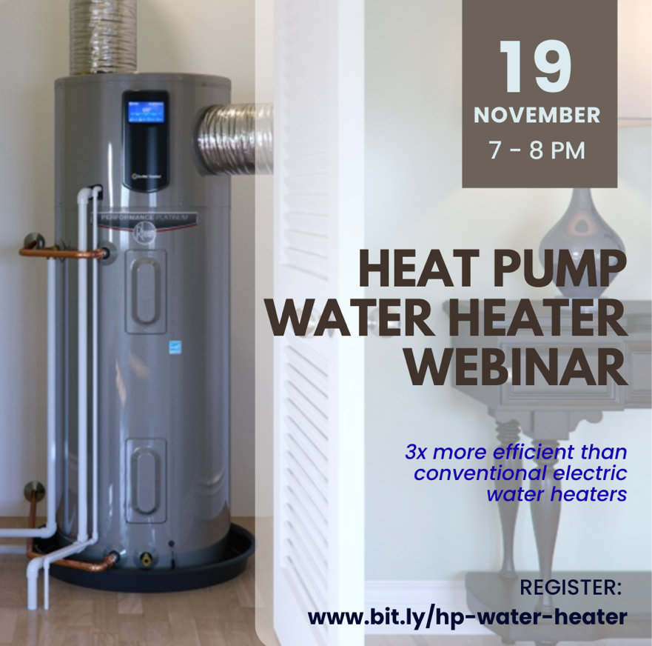
Get Yourself Into (Efficient) Hot Water!
HEAT PUMP WATER HEATER WEBINAR
Join us to learn about the economic and environmental benefits of highly-efficient heat pump water heaters!
Don’t miss out on federal tax credits of up to $2,000 for qualifying heat pump water heaters, or up to $3,200 total annually for all eligible home energy upgrades! These incentives expire at the end of 2025 and can be combined with Mass Save rebates for even greater savings.
Nov 19, 7–8 pm | Register: www.bit.ly/hp-water-heater

Slide 2
Join us to learn about the economic and environmental benefits of highly-efficient heat pump water heaters!
Don’t miss out on qualifying federal tax credits of up to $2,000 that can be combined with Mass Save rebates for even greater savings.
Nov 19, 7–8 pm | Register: www.bit.ly/hp-water-heater
Join us to learn about the economic and environmental benefits of highly-efficient heat pump water heaters!
Don’t miss out on qualifying federal tax credits of up to $2,000 that can be combined with Mass Save rebates for even greater savings.
Nov 19, 7–8 pm | Register: www.bit.ly/hp-water-heater
Join us to learn about the economic and environmental benefits of highly-efficient heat pump water heaters!
Don’t miss out on qualifying federal tax credits of up to $2,000 that can be combined with Mass Save rebates for even greater savings.
Nov 19, 7–8 pm | Register: www.bit.ly/hp-water-heater
Join us to learn about the economic and environmental benefits of highly-efficient heat pump water heaters!
Don’t miss out on qualifying federal tax credits of up to $2,000 that can be combined with Mass Save rebates for even greater savings.
Nov 19, 7–8 pm | Register: www.bit.ly/hp-water-heater

